Slide 1
TOP TECH TRENDS FOR 2018
UTILITY PERSPECTIVE
Özcan Çavuş
PMO, Architecture and BI Group Manager, EnerjiSA

Slide 2
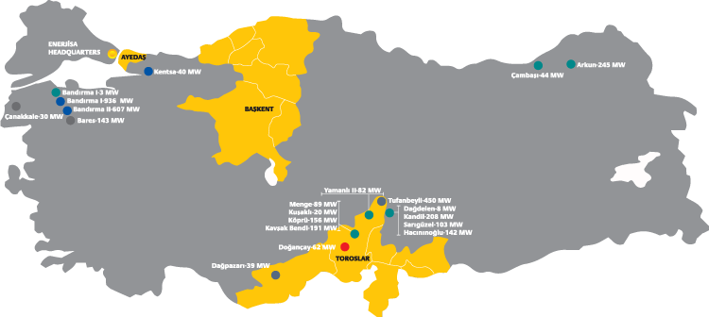
Enerjisa At a Glance
ENERJISA, a 50/50 JV between Sabanci and E.ON, the leading power company in Turkey
→ 3 distribution regions → Distribution network of 214,000 km
9 million installations – 25 million citizens → 6000 workers in field
Generation capacity of 3.6 GW →20.000 calls/day from call center (distribution-retail)
Notes:
OZCAN

Slide 3
Enerjisa Business Domains
Retail
Distribution
Customer
Product
Service Quality
Investments
Reduction of Opex
Theft & Loss
Generation
Trading
Availability
Productivity
Portfolio Optimization
Trading
Demand & Price Forecasting
JV
Notes:
OZCAN

Slide 4
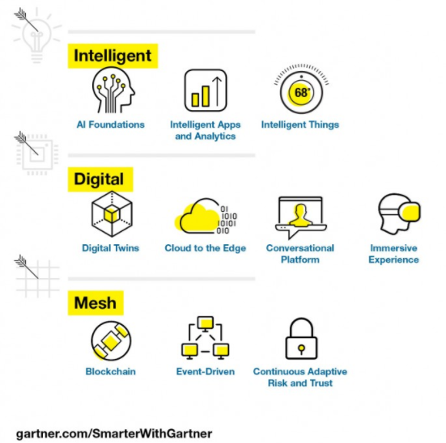
Top 10 Tech Trends
By 2020, IoT technology will be in 95% of electronics for new product designs.
In 2020, AI will become a positive net job motivator, creating 2.3M jobs while only eliminating 1.8M jobs.
By the year 2020, the banking industry will derive $1B of business value from the use of blockchain-based cryptocurrencies.
By 2020, 5 of top 7 digital giants will willfully self-disrupt to create their next leadership opportunity.
By 2020, event-sourced, realtime situational awareness will be a required charecteristic for 80% of digital business solutions.

Slide 5
Top Tech Trends for Enerjisa 2018
AI - Chatbots
1
Consumer , Corporate Solutions & Products
2
Experience enhancing digital capabilities
3
New business models
In the areas of
Advanced Analytics - ML
Cybersecurity
We are looking for
Internet of things
Robotics
Process
Automation
Smart cities
Blockchain
Smart home- Edge Computing
Notes:
for acquiring new customers and retaining existing ones or increasing the wallet share of Enerjisa

Slide 6
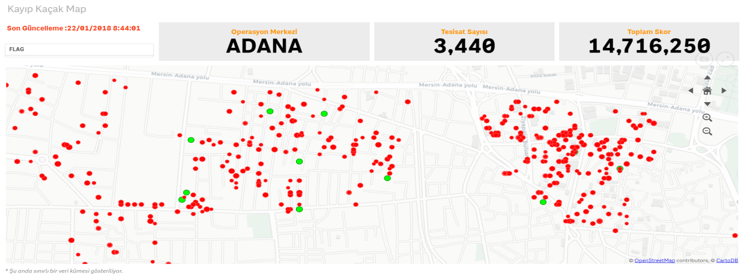
Theft Analytics & Revenue Optimization
Objective and Rationale
Difference between purchased energy and invoiced energy is compound of Technical Loss and Non-Technical Loss(Theft). This project’s aim is to detect, compute and display of Non-Technical Loss.
Facts and Figures
Non Technical Loss (Theft) detection scenarios developed
More than 400 features used for the Theft Detection
Automated alarm generation based on Advanced Statistical Analytics Models ( LR , DT, Random Forest )
Optimization of work orders regarding the max return value
Achievements
Increase in Hit Rate by 15%
Increase in #Works by 10%
Detection of faulty meters

Slide 7
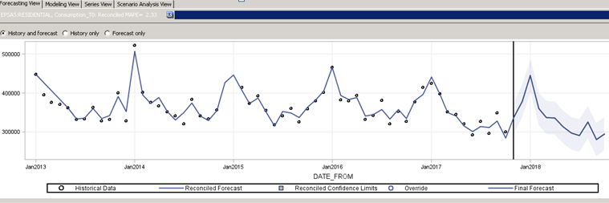
Short Term Load Forecasting
Objective and Rationale
Forecasting all of our regulated and eligible customer’s consumption
Decreasing imbalance cost resulting from Short Term Energy Purchasing Actions
Setting up a fully integrated forecasting environment in order to minimize redundant efforts and manual human intervention
Facts and Figures
Use of Internal (MDM) and External Data Sources in forecasting process (Weather, Seasonality, Economic Factors)
* Use of Time Series and Machine Learning algoritms. 15K+ models run regularly
Achievements
Improvement ~%7 => ~%3 by means of error rate

Slide 8
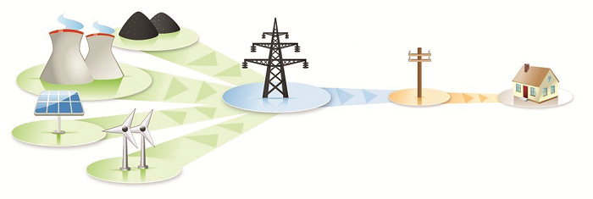
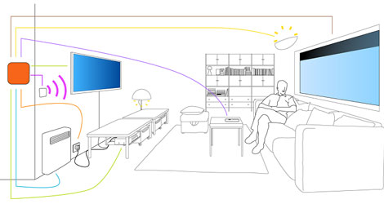
Smart Home/Box - Episode 2
Analytics
Land
Episode 1
7x24 Customer experience
7x24 Real-time big data
Hadoop - NoSQL - Spark
AI / Machine Learning
Episode 2 – Within house

Slide 9
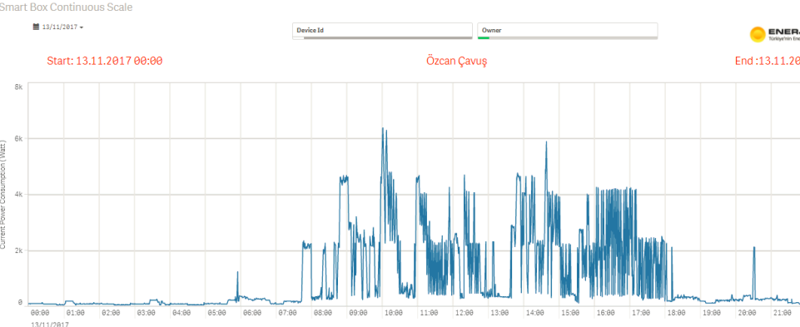
Smart Home/Box IoT Project
Refrigerator works efficiently (or not)
Base consumption level comparison
Forgot to turn off any device when leaving home
Reaching reactive energy upper limit (for SMEs)
Smart plug usage for water heater
Insights
Summer house
Size of households
Wake-up time
Children Arrival Time
Sleeping time
Daily Routines

Slide 10
Thank You

