Slide 1
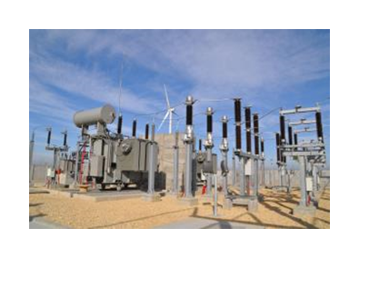
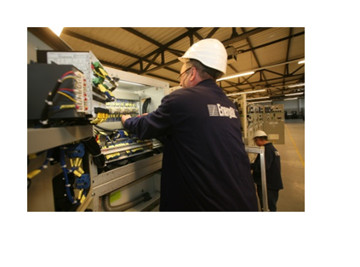
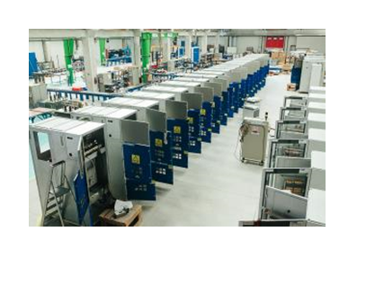
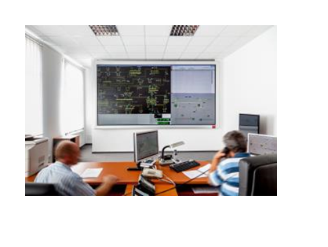

Slide 2
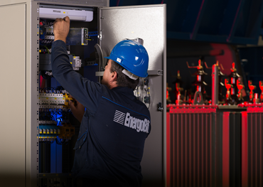
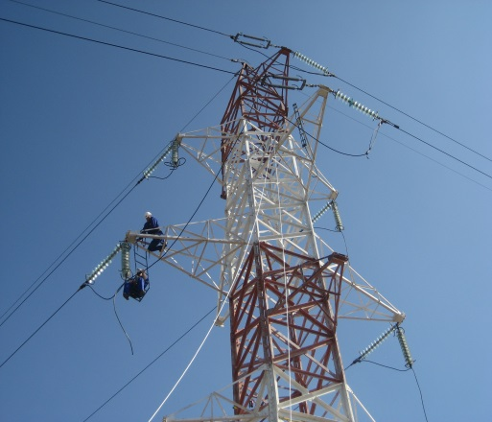
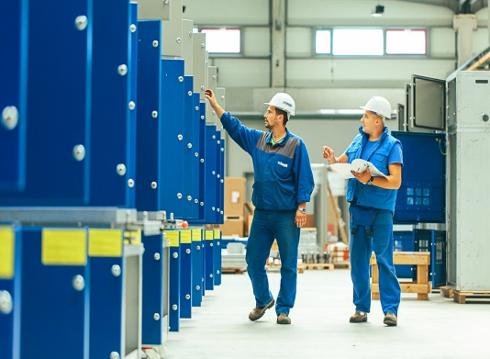
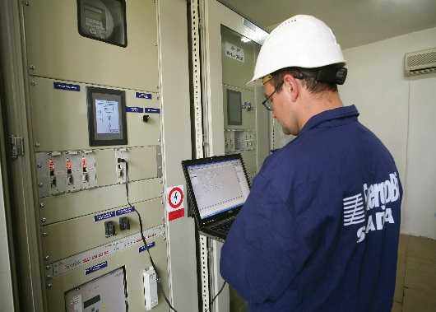
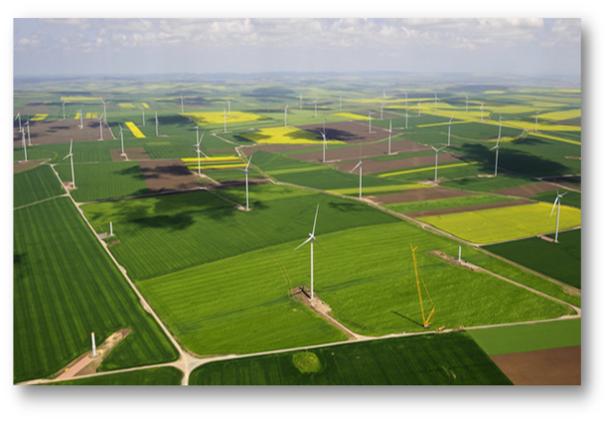
EnergoBit - the complete solution in electricity
production of prefabricated MV/LV transformer substations, MV switchgears for primary and secondary distribution, LV panels, low and ultra low MV/LV oil insulated transformers;
solutions for protection, SCADA, metering and monitoring systems;
general contractor for energy projects;
operation and maintenance.

Slide 3
EnergoBit in figures
65 mil EURO turnover;
700 employees;
63 power substations commissioned since 2001;
50.000 electrical equipment produced in our factories;
2.000 MW installed in renewable projects.

Slide 4
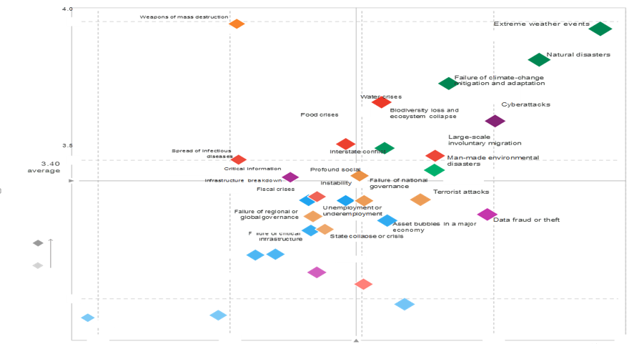
Global Risks Landscape 2018
Source: WEF- Davos Economic Forum

Slide 5
10 years top 5 risks evolution
Likelihood
Impact

Slide 6
Key trends to watch in 2018

Slide 7
The Past and Future Electricity System

Slide 8
6 key focus areas- power and utilities in 2018

Slide 9
Our solution: high quality

