Slide 2
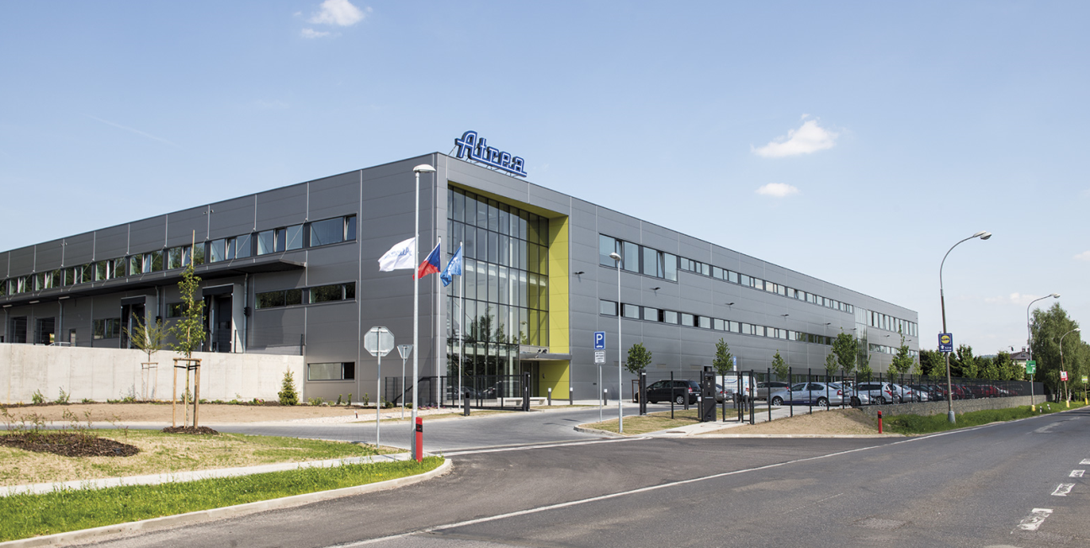
HEADQUARTERS IN THE CZECH REPUBLIC
General info
+

Slide 3
WHO ARE WE?
ATREA
Private family company
Founded in 1990
300 employees

Slide 4
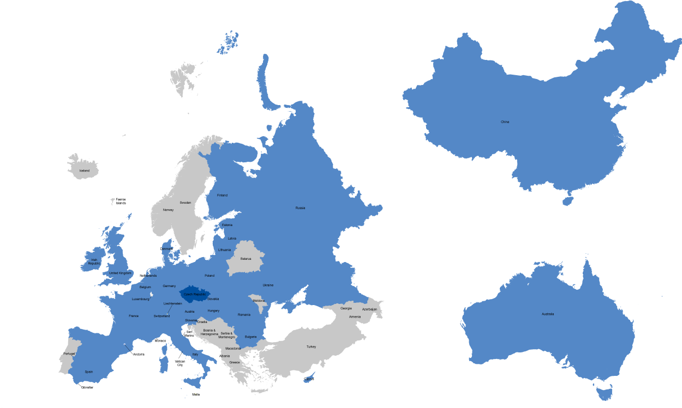
WHO ARE WE?
ATREA is an export company

Slide 5
WHO ARE WE?
ATREA
International holding
More than 23 countries (Germany, Denmark, Switzerland, UK, ..)
Own companies in Czech Republic, Slovakia, Hungary, Romania, Bulgaria and Austria

Slide 6
WHO ARE WE?
ATREA is member of EVIA
Atrea is member of European Ventilation Industry Association.
Along with other 43 members represent the ventilation industry both in Brussel and relevant stakeholders and in the national capitals.

Slide 7
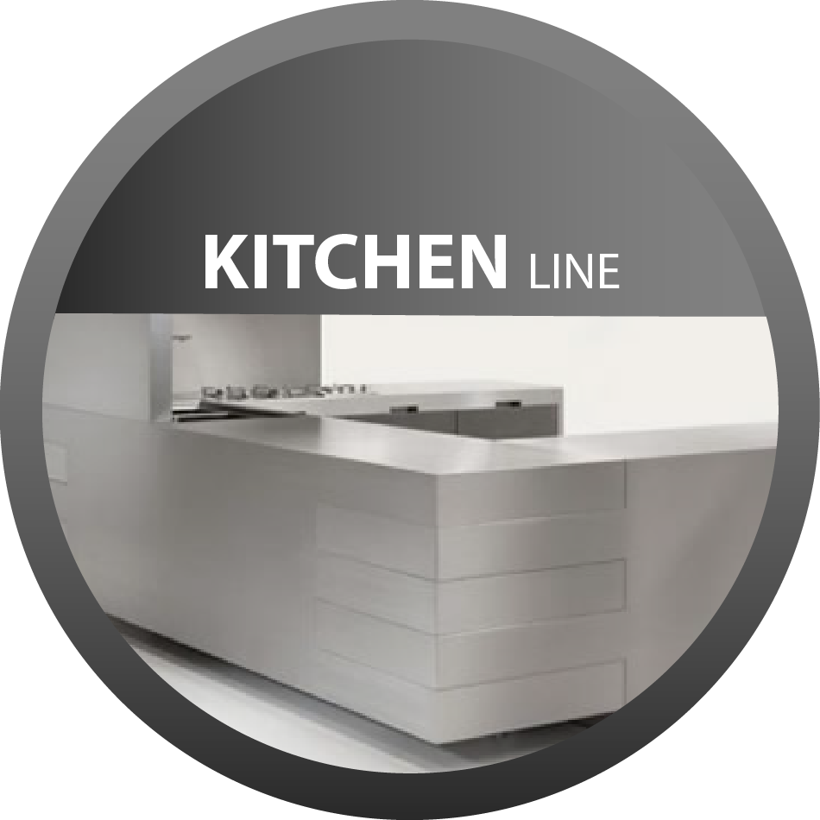
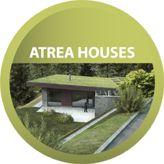

Slide 8
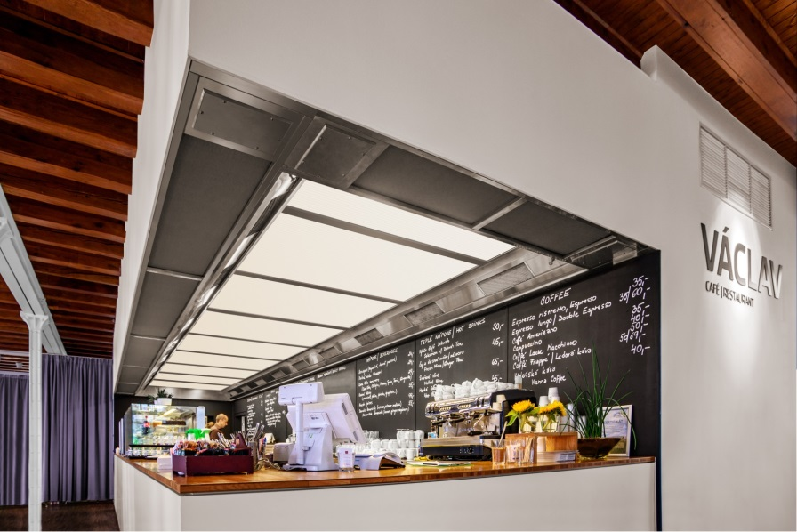
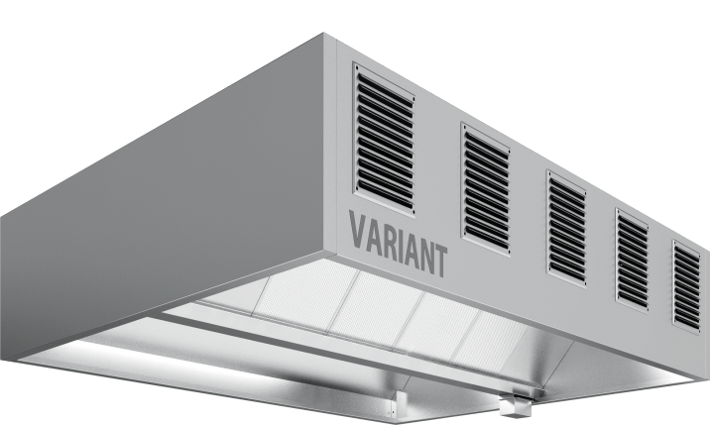
VENTILATION CEILINGS KITCHEN HOODS
Kitchen line

Slide 9
VENTILATION CEILINGS
Kitchen line

Slide 10
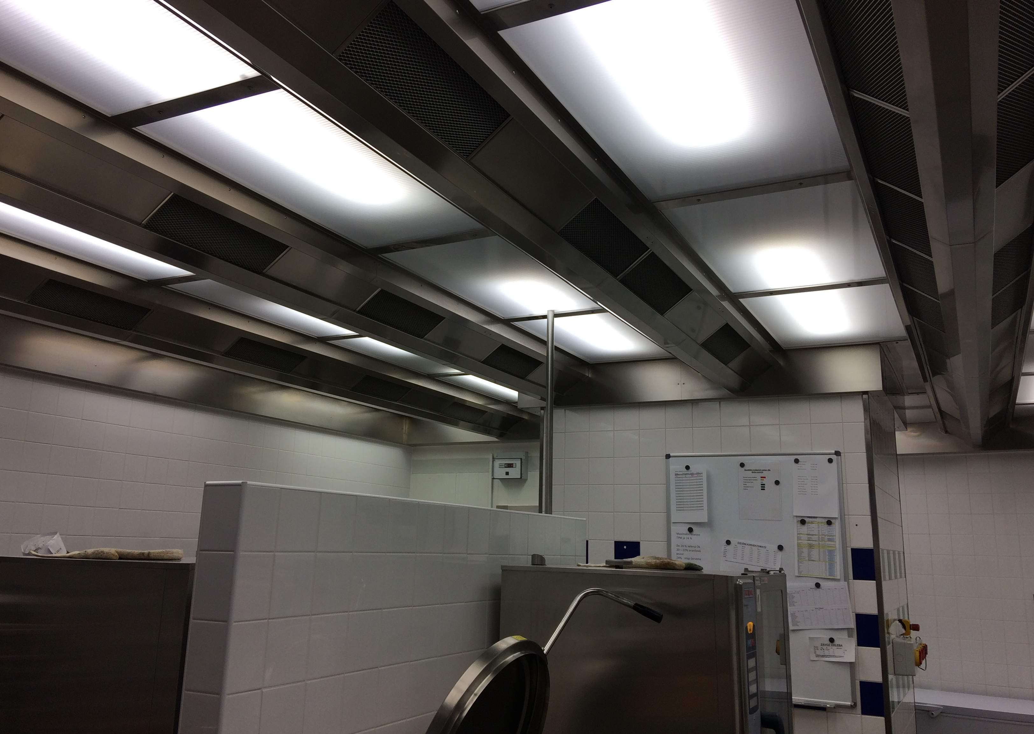
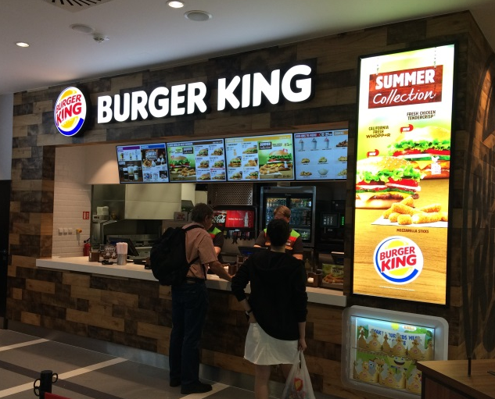
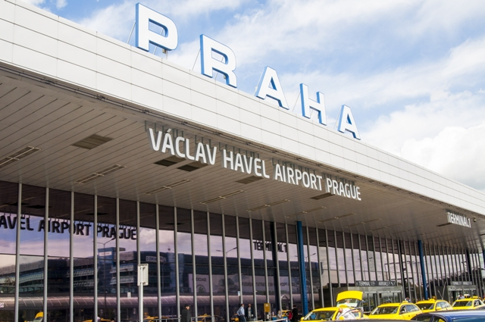
Kitchen line
Restaurant: Burger King
Locatia: Aeroport Praga
Suprafata plafonului: 80 m2

Slide 11
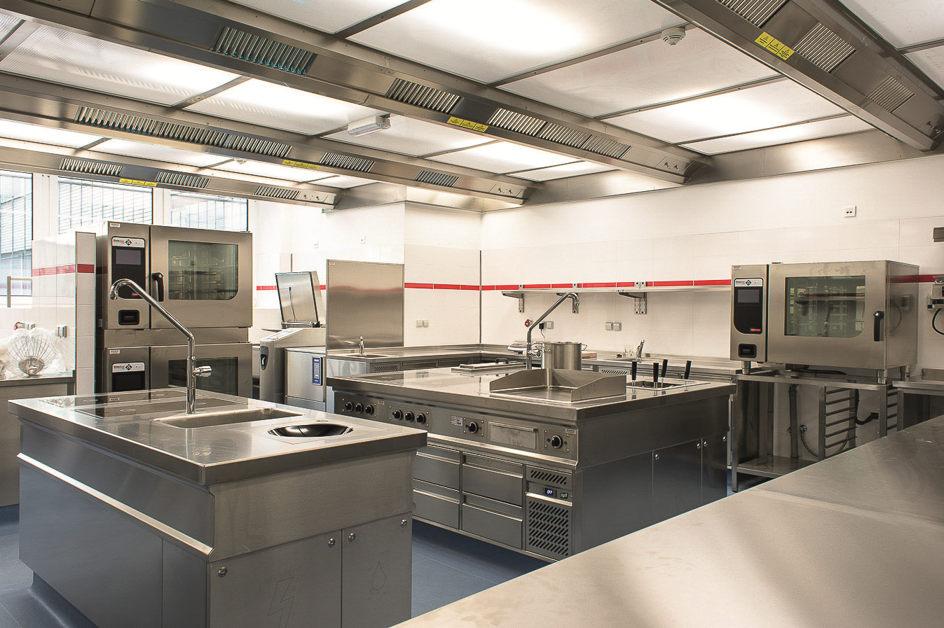
Kitchen line
Restaurant CZECH HOUSE
Locatia: Moscova
Suprafata plafonului: 145 m2

Slide 12
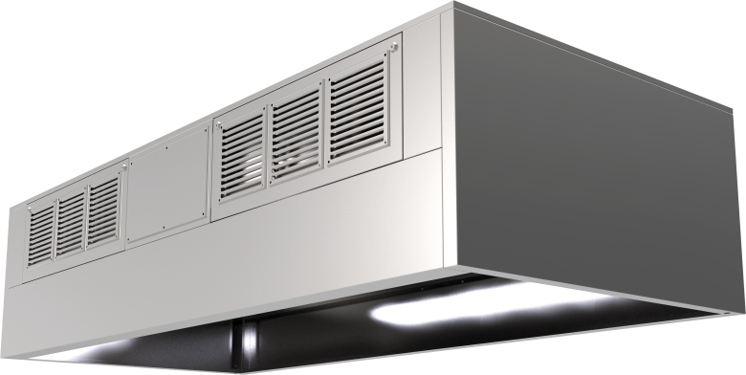
VARIANT
Kitchen line
DiNER
1)Air extraction
2)Filtration
3)Lighting
4)Air supply
1)Air extraction
2)Filtration
3)Lighting
4)Air supply
5)Heat recovery

Slide 13
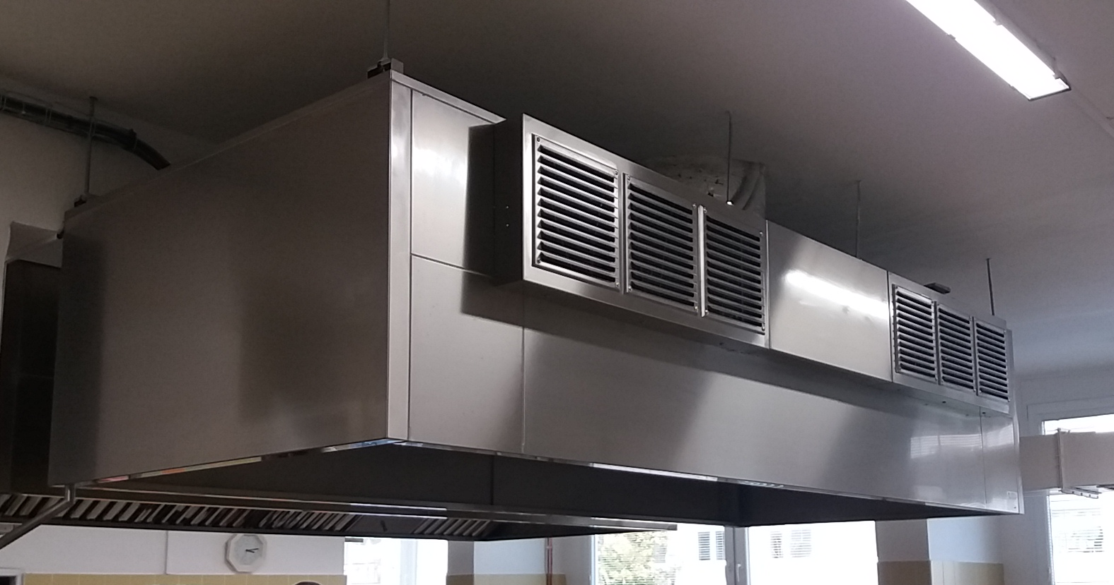
Kitchen line
Restaurant: Kindergarten Ctyrlistek
Locatia: Czech Rep.
Hota: DiNER

Slide 14
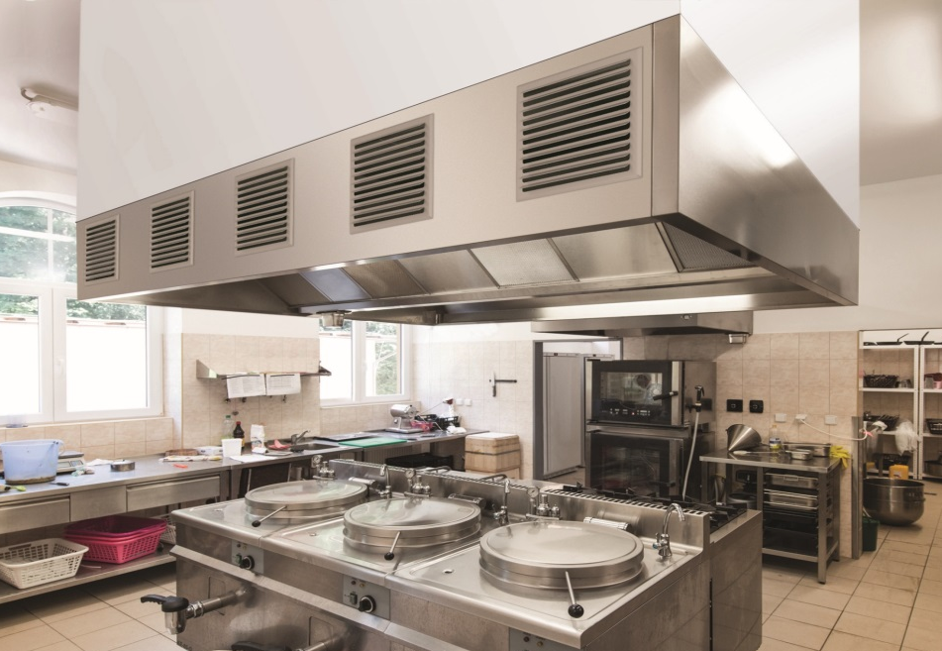
Kitchen line
Restaurant: PASEKY
Locatia: Czech Rep.
Hota: Variant

Slide 15
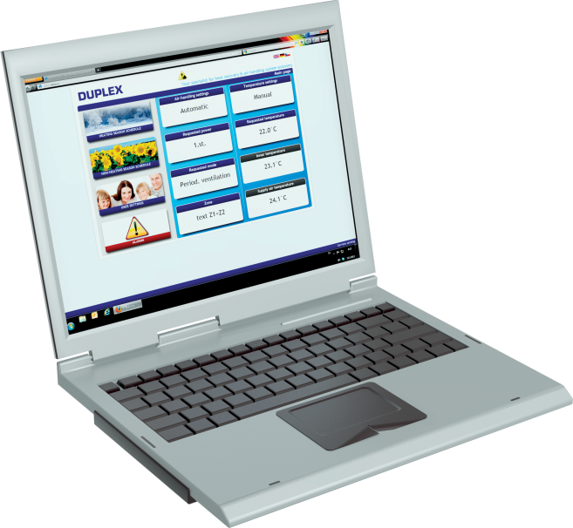
CONTROL SYSTEM for commercial kitchens
Kitchen line
available with ATREA products as a complete package
possibility to ventilate zones
controlling via web server

Slide 16
Commercial line

Slide 17
Commercial line
DUPLEX units
500 – 15 100 m³/h
Compact, small units
Indoor / outdoor installation

Slide 18
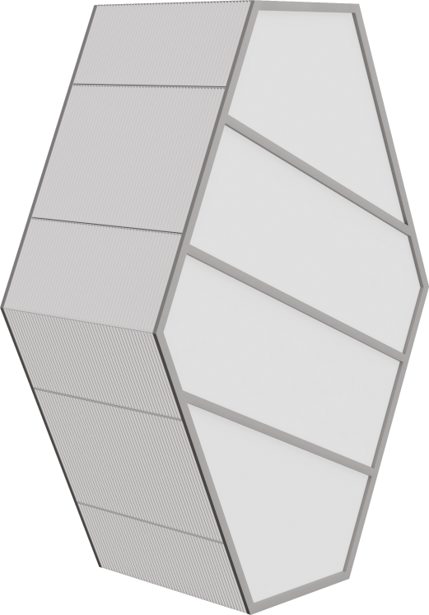
Products
High quality components
HEAT exchangers – own production !
Counterflow (up to 93%)
Rotary (up to 85%)
Crossflow (up to 75%)
ATREA has them all!

Slide 19
Certification
In compliance with Ecodesign 2016 and 2018
PHI certificate
TÜV - VDI 6022
Eurovent

Slide 20
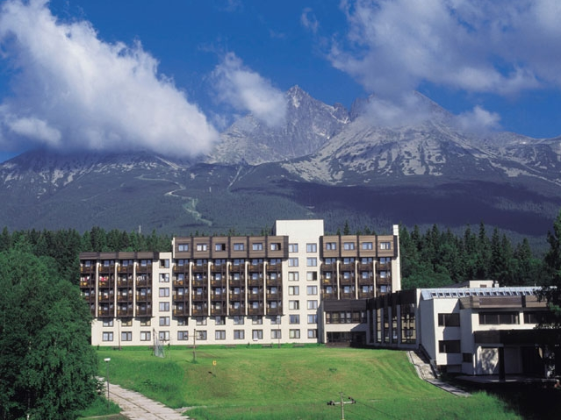
Commercial line
HOTEL HUTNIK, SLOVACIA
DUPLEX 15000 Roto – camere de hotel
DUPLEX 4500 Multi ECO – restaurant
DUPLEX 15100 Basic – extractie bucatarie

Slide 21
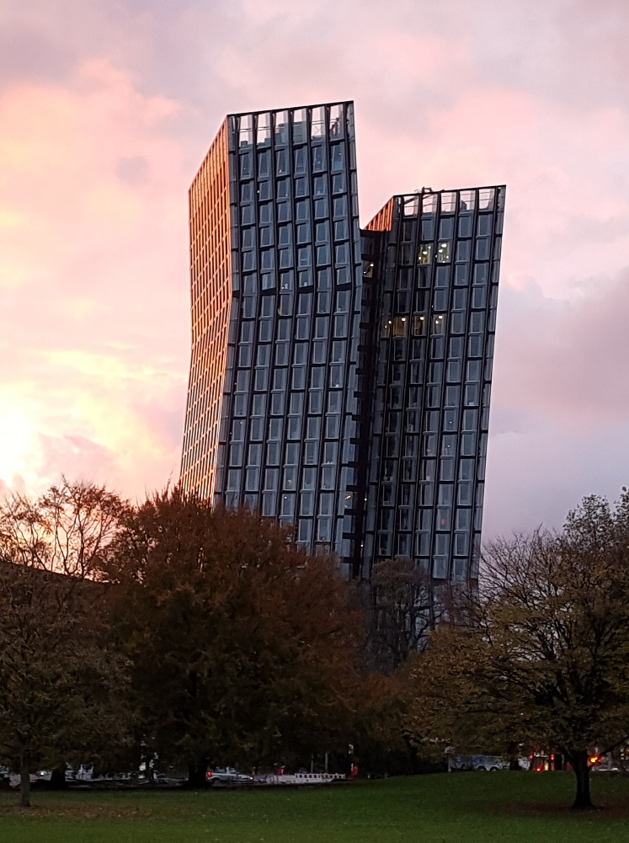
Commercial line
Cladire de Birouri: Dancing Tower
Locatie: Hamburg
Duplex Multi 5000 25 unitati

Slide 22
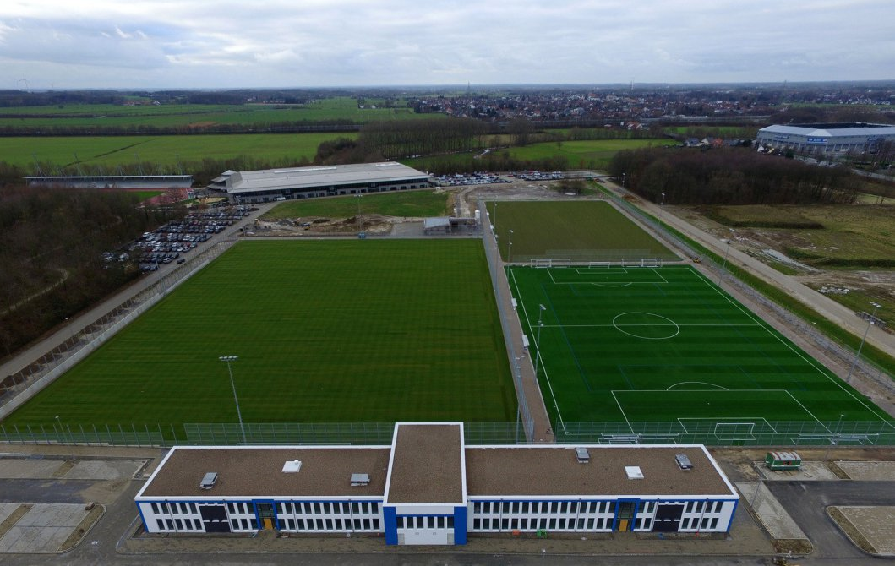
Commercial line
Stadion de Fotbal
Locatie: Paderborn, Germania
Duplex Multi ECO

Slide 23
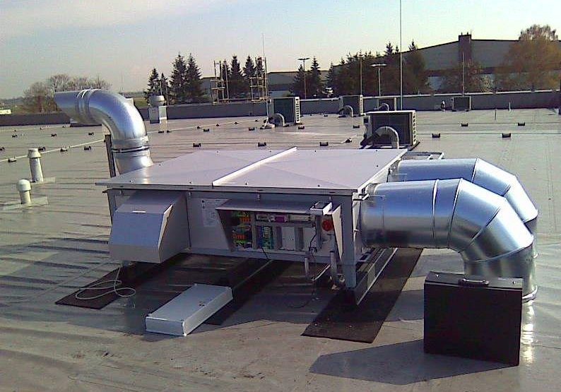
Commercial line
Aeroport Dusseldorf
Locatie:Germania
Duplex Multi ECO-N

Slide 24
Domestic line

Slide 25
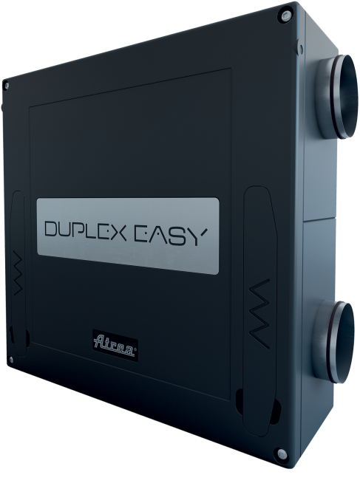
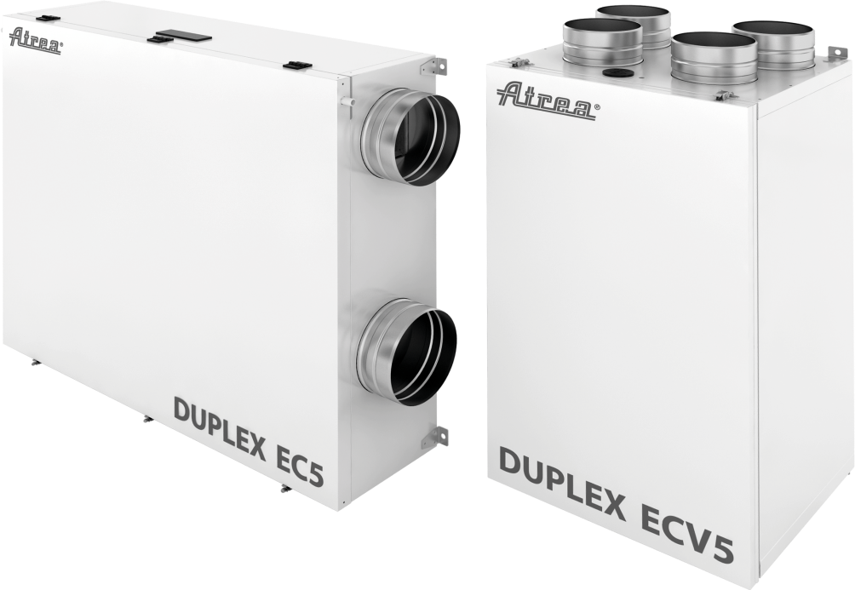
DUPLEX EC5/ECV5 DUPLEX Easy 170 – 580 m³/h 250 - 400 m³/h
Residential line

Slide 26
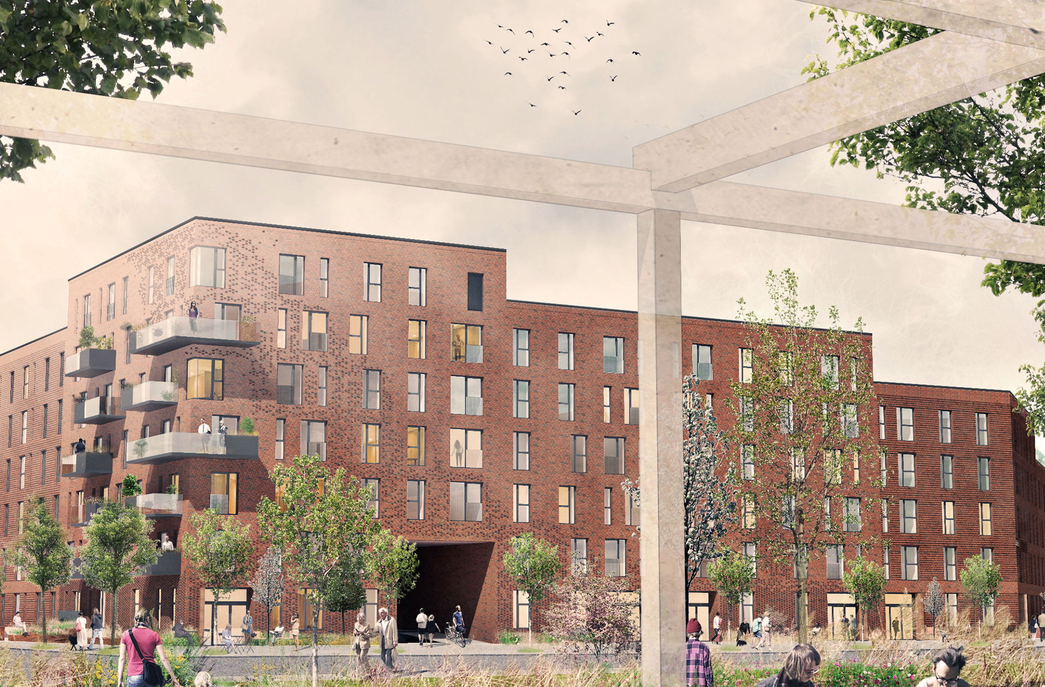
Domestic line
Bloc de apartamente
Locatie: Copenhaga, Danemarca
Duplex EC5 370, RD5

Slide 27
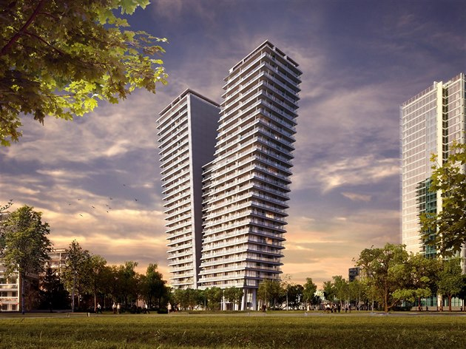
Domestic line
Clădire de birouri ”V Towers”
Locatie: Prague, CZ
Duplex RS5

Slide 28
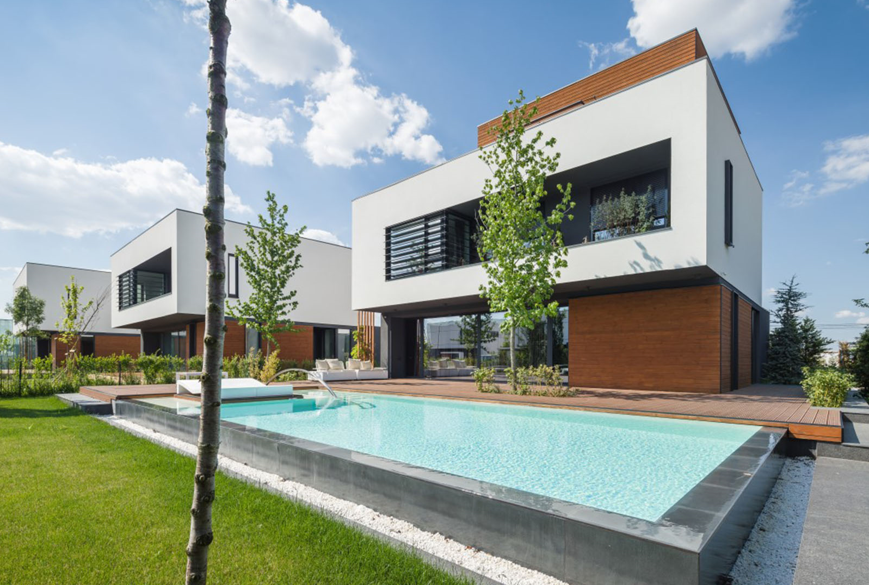
Domestic line
Complex de case pasive ”Amber Gardens”
Locatie: Otopeni, Romania
Duplex EC5/ECV5

Slide 29
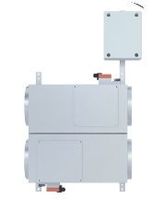
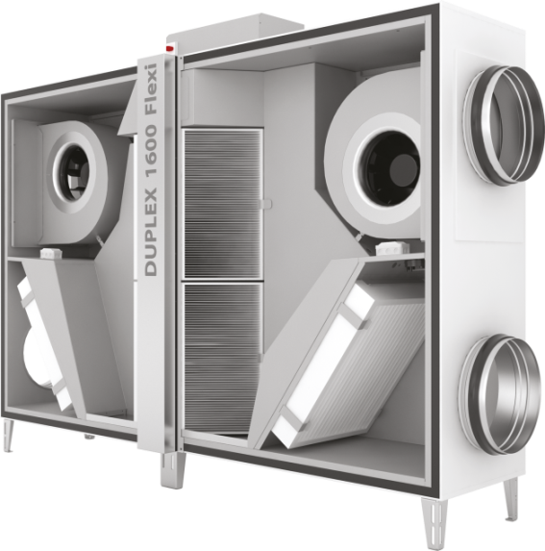
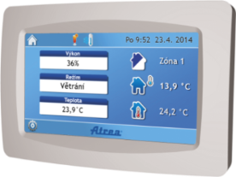
SMART box system by ATREA
separate VAV regulator
ATREA VAV
control system
ATREA RD5
central ventilation
ATREA line
complete ventilation system from one producer with clear guarantee

Slide 30
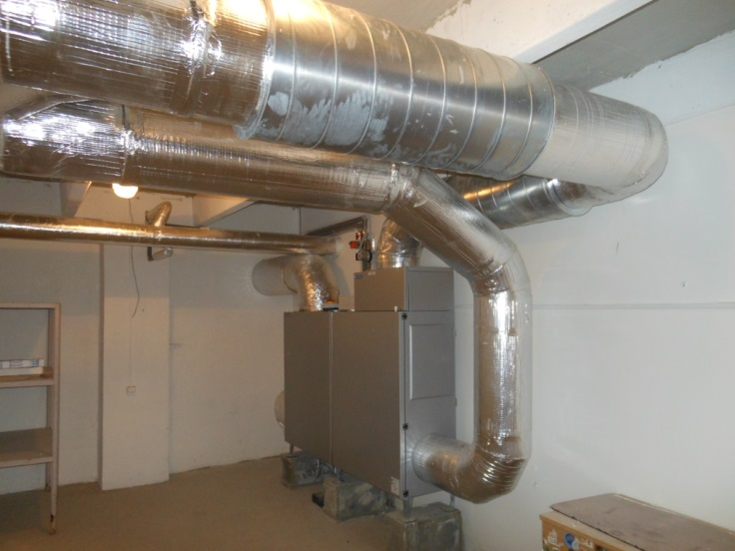
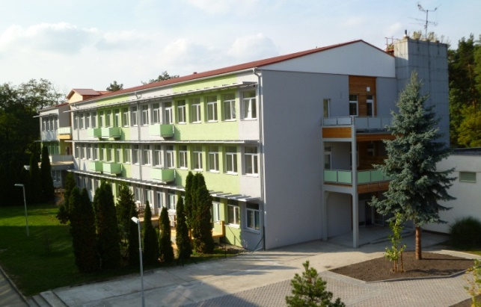
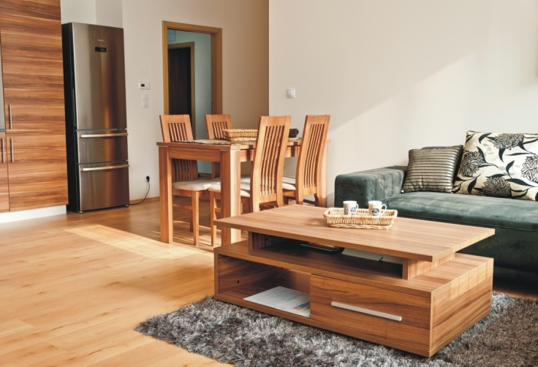
Project references
Apartment building in Dubňany:
Two central unit / 23 Smart boxes

Slide 31
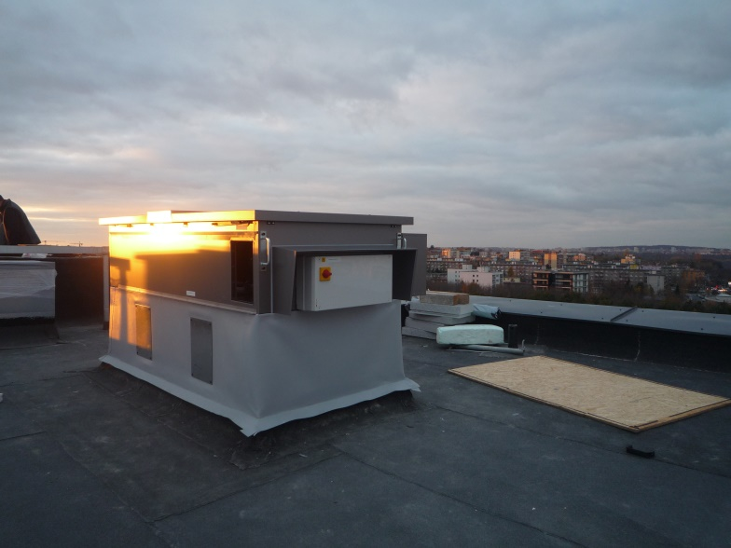
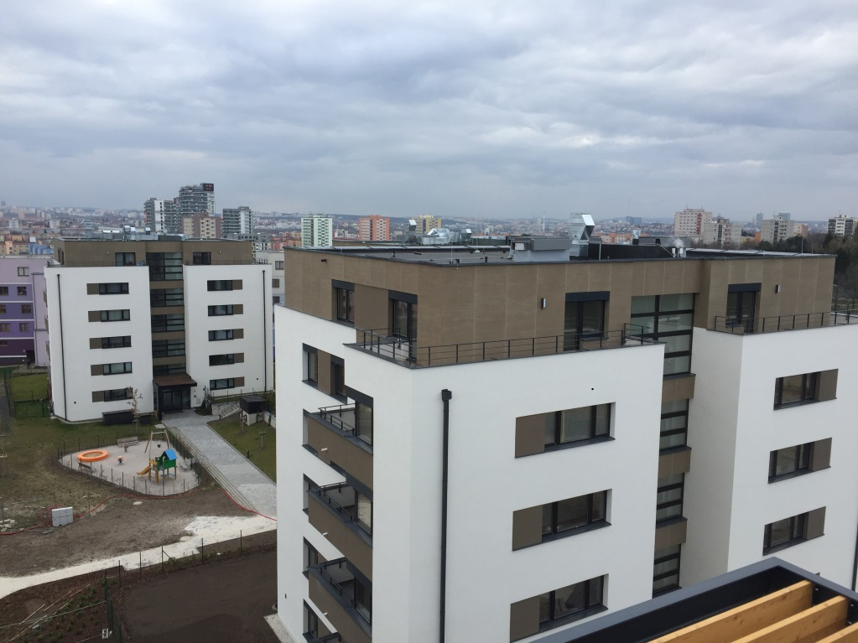
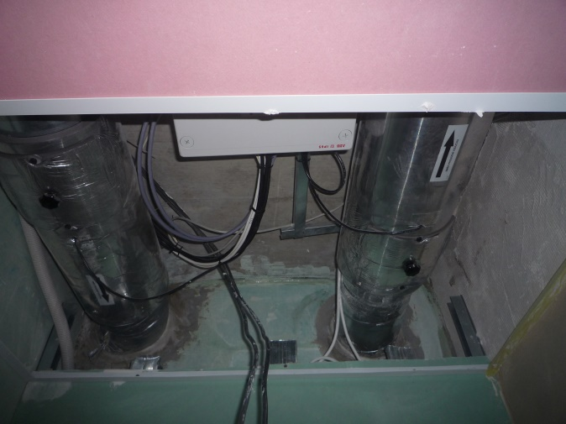
Project references
Apartment building EcoCity -Prague:
5 towers/115 Smart boxes

Slide 32
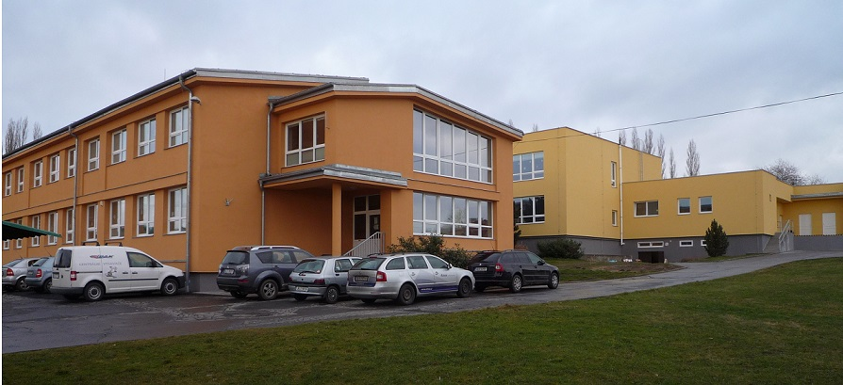
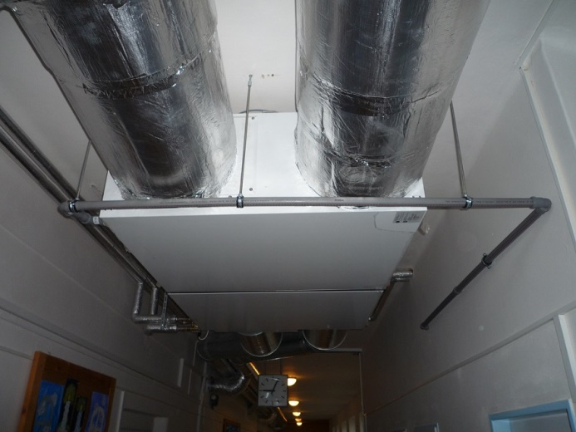
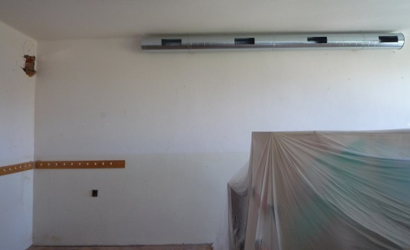
Project references
Elementary school in Jenišovice:
Tree central unit / 10 Smart boxes

Slide 33
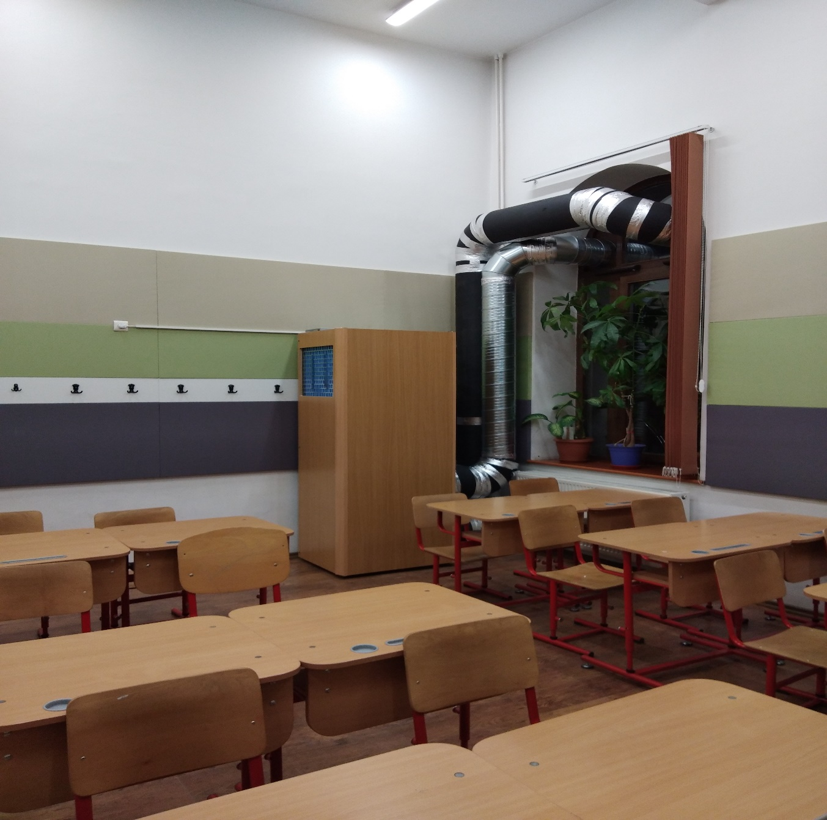
Project references
LOCATIE:LICEUL
„MIHAI VITEAZUL” BUCURESTI
DUPLEX INTER 850

Slide 34
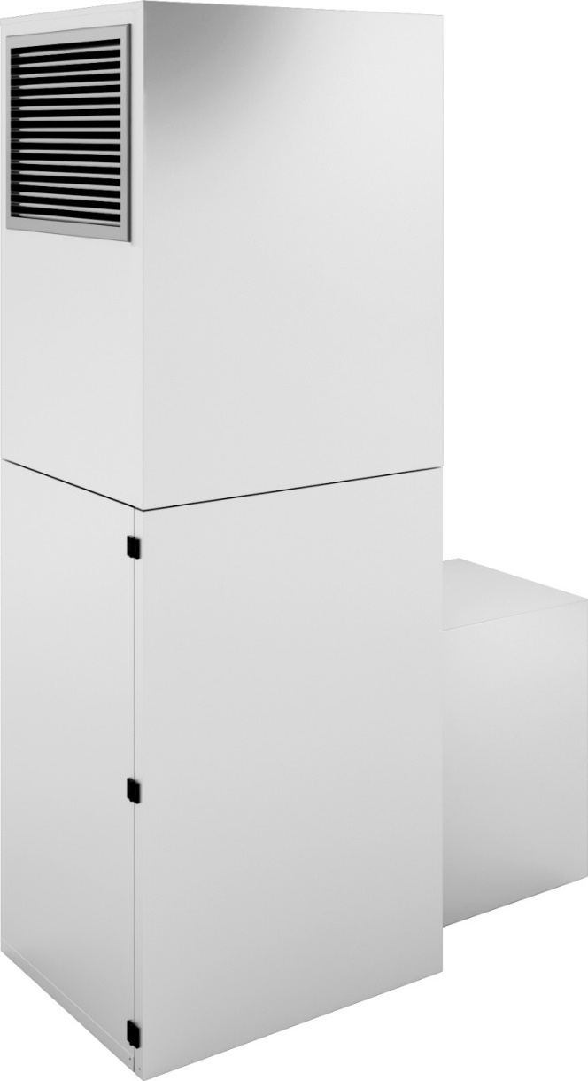
School ventilation system
DUPLEX 850 INTER
Compact vertical unit
High efficiency
Very low sound level
Integrated control system RD5
Accessories included

Slide 35
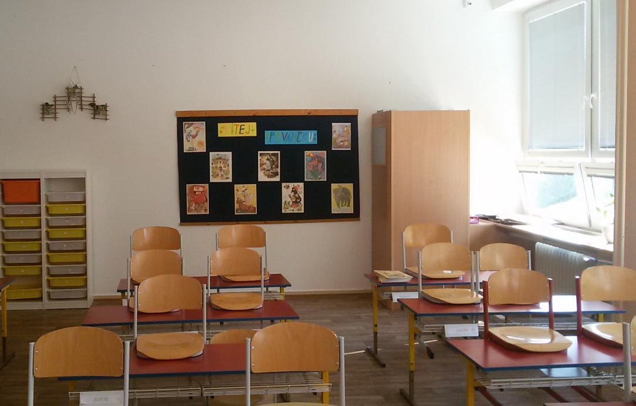
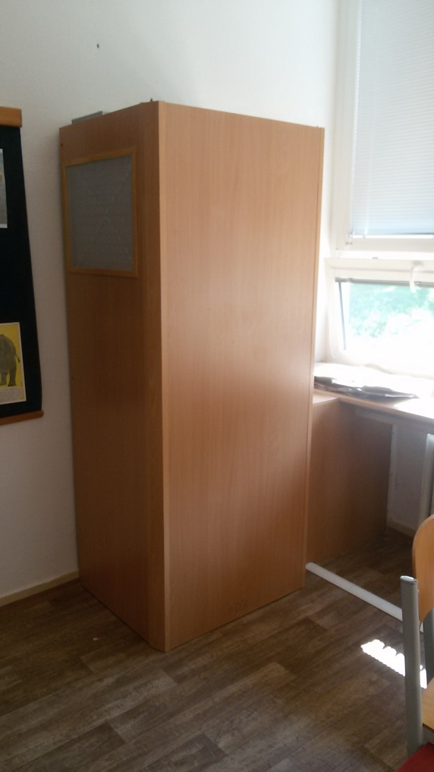
Project references
LOCATIE:ZŠ Generála Janka; CZ
DUPLEX INTER 850

Slide 36
Thank you for your attention
ATREA s.r.o.  Čs. Armády 32, 466 05 Jablonec n. Nisou  tel.: +420 483 368 111  www.atrea.cz  atrea@atrea.eu

