Slide 1
Writing the digital future takes ability. ABB Ability™.
February , 2018
ABB Romania Country Managing Director
Tomasz Wolanowski

Slide 2
Agenda
The digital revolution – coming now to industrial markets
ABB Ability™
Conclusions
Notes:
In this presentation, we will cover how technology innovations are primed to transform the industrial markets that ABB serves.
We’ll also discuss what is required to win in the digital arena and how ABB is well positioned.
We have a wide range of industry-leading solutions today, which will increasingly be developed on a common technology platform.
This platform is a set of re-usable technical components and will allow our solutions to be deployed on premise, in the cloud, and between clouds
And this is not a statement about the future — it is about solutions that customers are deploying today.

Slide 3


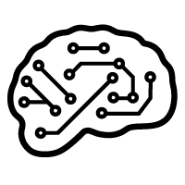


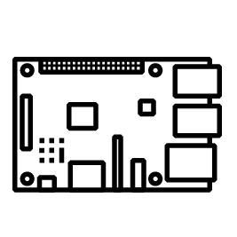




Digital technologies are driving new innovation in industrial markets
Media is focused on B2C but the “killer app” is in B2B
Virtual/augmented reality
Software-defined machines
Machine learning
Time-sensitive networking
Big data
Inexpensive computing
Cloud computing
Cybersecurity
Connectivity
Blockchain
Notes:
In the 1980s, some of the best technology was coming from government research labs (e.g. NASA, etc.).
In the 1990s, businesses started deploying personal computers, local area networks, and connecting to the Internet so the enterprise had the lead in technology.
Since the 2000s however, the innovation in technology moved to the consumer space (mobile phones, social networking, streaming media). This has led to explosive improvements in computation, storage, and connectivity. Those technologies are now spilling over to the industrial markets and are causing a massive opportunity for new value creation.

Slide 4












ABB is in the “eye of the storm” for massive value migration
A $4 – 11 trillion digital opportunity by 2025
Range of sized potential economic impact
Low
High
Disruptive technologies will have substantial impact by 2025 (economic impact of 12 most significant technologies, $ trillions, annual)
1
Internet of Things
3.9 – 11.1
2
Mobile internet
3.7 – 10.8
3
Automation of knowledge work
5.2 – 6.7
4
Cloud technology
1.7 – 6.2
5
Advanced robotics
1.7 – 4.5
6
Autonomous and near-autonomous vehicles
0.2 – 1.9
7
Next-generations genomics
0.7 – 1.6
8
Energy storage
0.1 – 0.6
9
3D printing
0.2 – 0.6
10
Advanced materials
0.2 – 0.5
11
Advanced Oil & Gas exploration and recovery
0.1 – 0.5
12
Renewable energy
0.2 – 0.3
Notes:
McKinsey Global Institute has listed the impact of these technologies and for the markets that ABB touches, this could be on the order of $4-11T by 2025. The economic impact is in terms of improvements in either productivity or cost reductions. The value will increasingly move from physical products to those enabled by digital technologies (software and connectivity). ABB is a key player in many of these markets, such as the Internet of Things (power grids, industrial automation), cloud technologies (using cloud software and supplying datacenter electrical equipment), the electrification of transportation, advanced oil & gas exploration, and supplying inverters and SCADA systems for renewable energy (for example, our microgrid systems).

Slide 5










Real-time is getting more important
What happens in an internet minute?
Every day, 2.5 quintillion bytes of data are created
900,000
logins,
15,000 GIFs sent via Messenger
30 hours
of video uploaded,
$751,522 spent online
4.1 million
Video views
156 million
email sent
120
new Linkedin accounts created
342,000
apps downloaded
20 new victims of identity theft
50 voice-first devices shipped
40,000
hours of music listened
3.5 million
search queries
1.8 million snaps created
1,300
new mobile users
70,017 hours watched
135
botnet infections
90% of global data has been generated in last 2 years alone

Slide 6

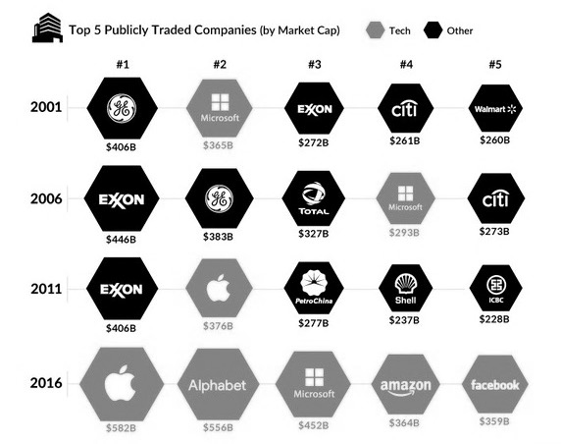
Top 5 publicly traded companies (by market cap) companies are now digital platform companies.
Source: Bloomberg
Notes:
Microsoft since 2001 amongst Top 5 market cap companies (except 2011)
Alphabet/Google, Amazon, Facebook were not even in the Top5 in 2011 (5 years ago)
From mainly asset rich companies (GE, Exxon, ...) to digital platform players.
What the top 5 have in common is that they leverage digital eco-system vs selling independent / individual products.

Slide 7
Emerging technology trends fueling Digital Adoption
Cost of building and operating “smart things” quickly dropping.
✓
✓
✓
Cost of sensors
Cost of bandwidth
Ubiquitous cloud infrastructure
20x
$1.30
.60
40x
avg. cost
cost per MB
over the past ten years
over the past ten years
over the past ten years
✓
✓
Cost of
processing power
Enough IP addresses
50x
IPv6
3.4 x 10³⁸
=
IP addresses
over the past ten years

Slide 8



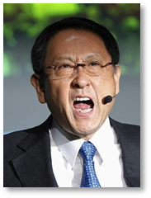
Disruption can happen much faster than expected
Toyota's U-turn on autonomous vehicles
2014
2016
"I won't trust autonomous cars until one can beat a human-driven car around the Nürburgring race course"
"I personally went through a big change in my thinking [...].
I believe there is a point in Toyota participating in autonomous driving"
Akio Toyoda,
Toyota CEO
  > $ 1 bn investment into driverless cars
  Recruitment of Silicon Valley talent (incl. former head of Google Robotics)
  Goal: Driverless cars on highways by 2020
"Toyota's main objective is safety, so it will not be developing a driverless car"
Seigo Kuzumaki,
Chief Safety Technology Officer
Notes:
BMW, Audi 2021

Slide 9
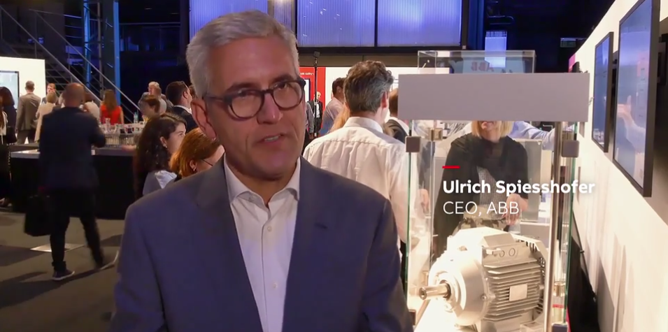
“ABB AbilityTM is part of the new DNA of our new ABB.
It’s our digital core combined with our physical competence with our strong domain expertise.
It’s not a project. It’s a long-term element of our value proposition.”

Slide 10
Agenda
The digital revolution – coming now to industrial markets
ABB Ability™
Conclusions
Notes:
In this presentation, we will cover how technology innovations are primed to transform the industrial markets that ABB serves.
We’ll also discuss what is required to win in the digital arena and how ABB is well positioned.
We have a wide range of industry-leading solutions today, which will increasingly be developed on a common technology platform.
This platform is a set of re-usable technical components and will allow our solutions to be deployed on premise, in the cloud, and between clouds
And this is not a statement about the future — it is about solutions that customers are deploying today.

Slide 11

ABB Ability™ solutions & platform
What
Delivers customer benefit (uptime, speed, yield…)
Utilities
solutions
Industry
solutions
Transport & Infrastructure solutions
ABB Ability™
Platform
(common technologies for device, edge, and cloud)
Provides ABB with efficiency and scale
How
Notes:
ABB Ability™ refers to both a set of industry digital solutions and the platform that they are built on.
We deliver these industry solutions in our 3 key markets: utilities, industry, and transportation & infrastructure.
The ABB Ability™ platform is a set of enabling technologies that lets ABB build these solutions more quickly and efficiently. We are building the platform from best-in-class industry technologies, such as Microsoft’s Azure cloud services, IBM Watson’s machine learning and AI, and SAP HANA’s big-data query tools.

Slide 12
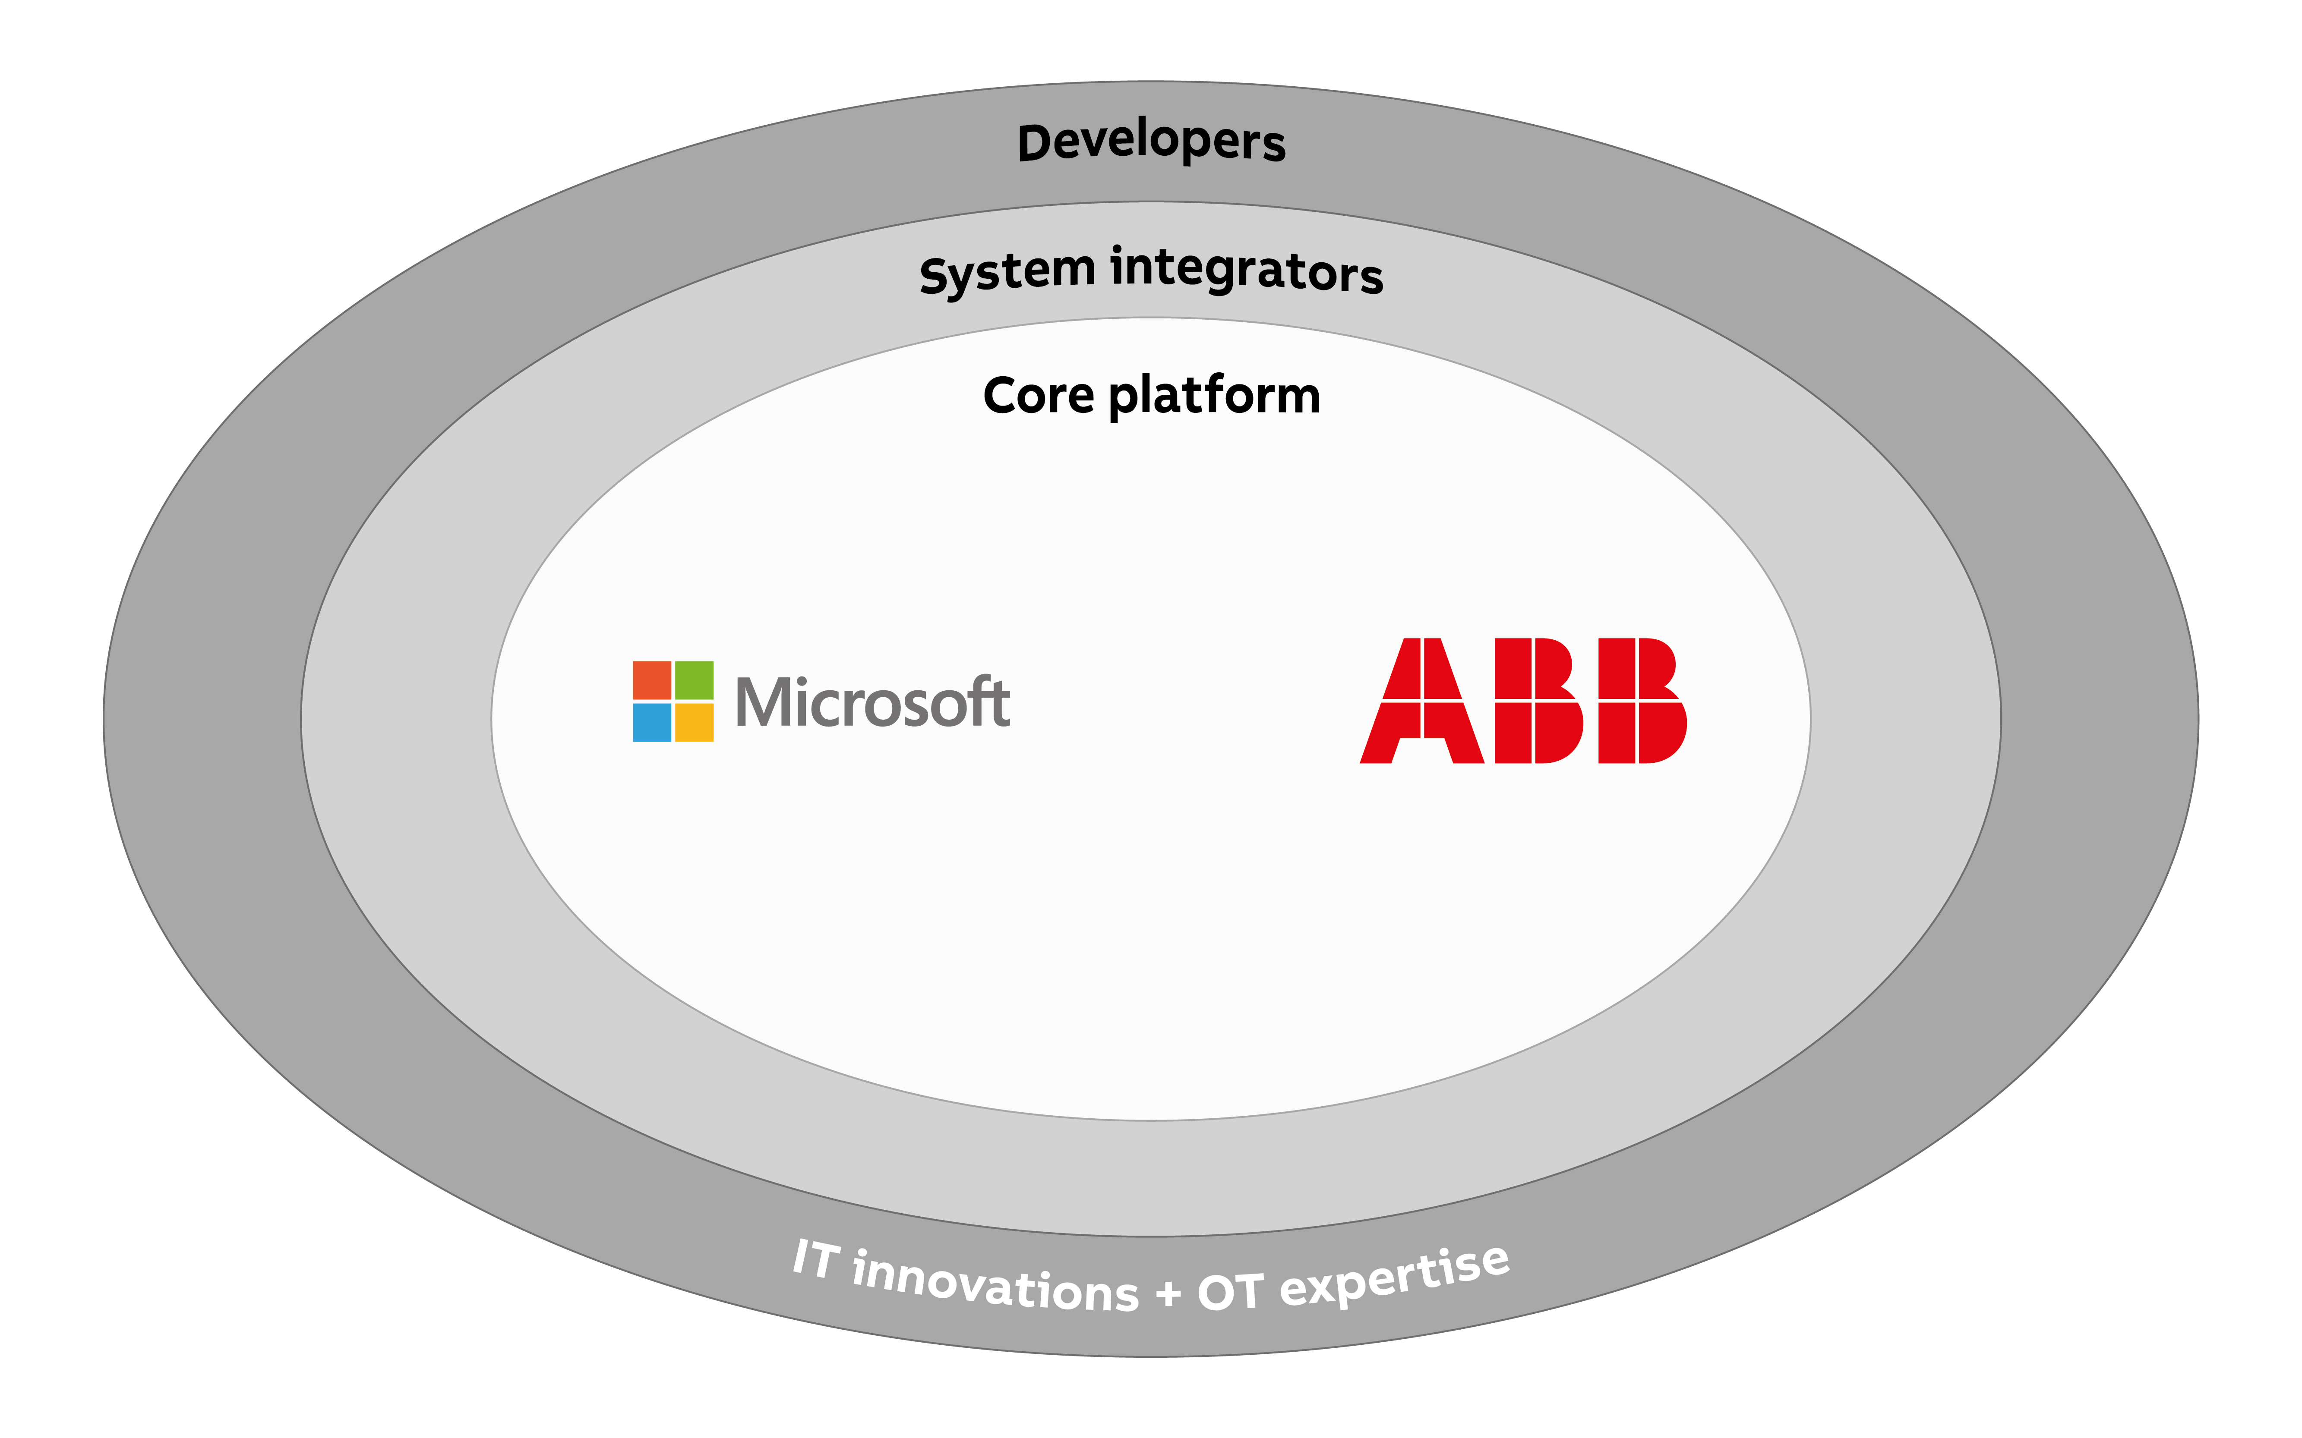
Benefits of an industry-standard platform
Suppliers x system integrators x developers x 3rd party apps = exponential leverage
Notes:
This approach lets customers access a broad ecosystem of system integrators and partners who have tens of thousands of developers who know how to use these tools already. This lets customers integrate ABB’s applications more quickly into other systems they have. Our customers can take advantage of their existing expertise in Azure, Watson, or HANA. Their system integrators are investing massively in expertise with those technologies, and in turn, there’s an ever increasing number of developers who are building systems on top of those technologies. This creates exponential leverage for our customers.

Slide 13
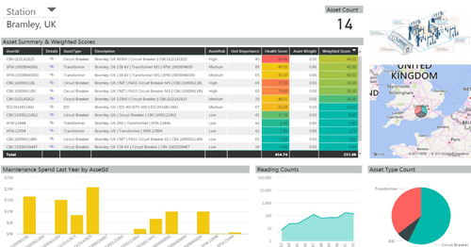
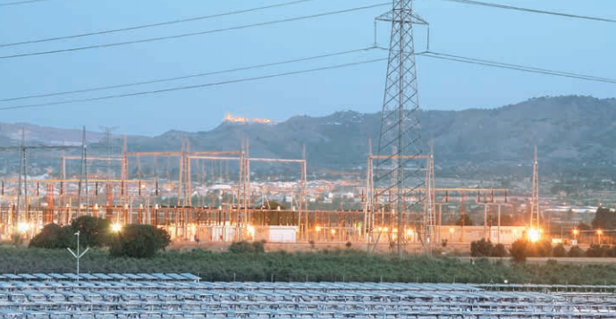
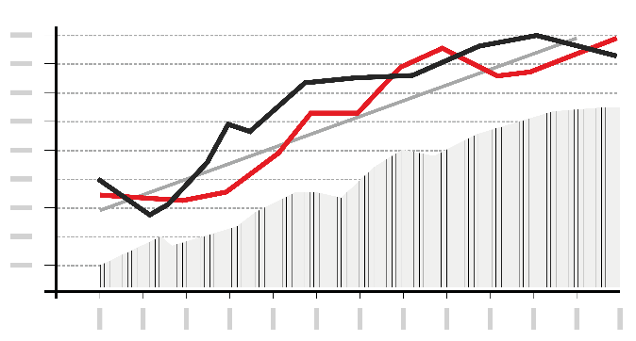

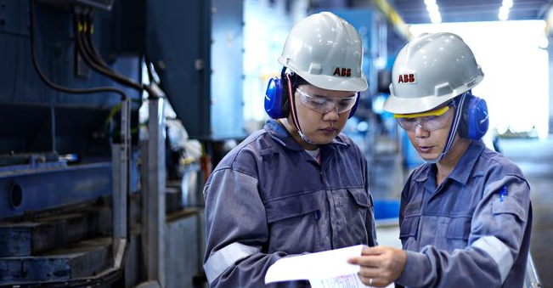
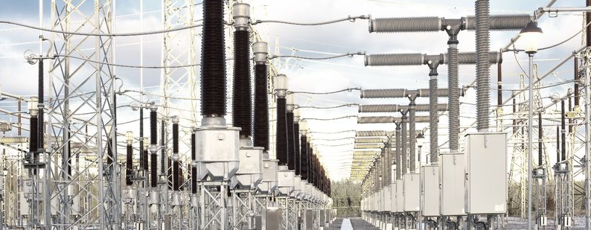
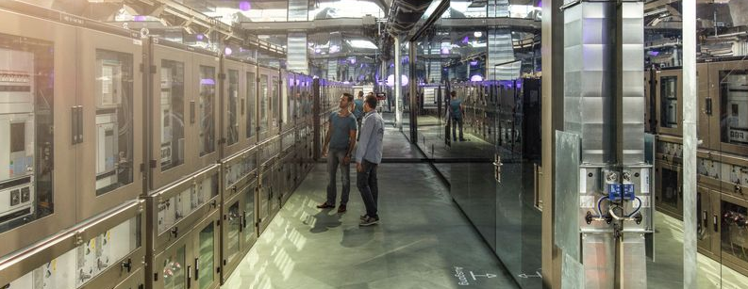
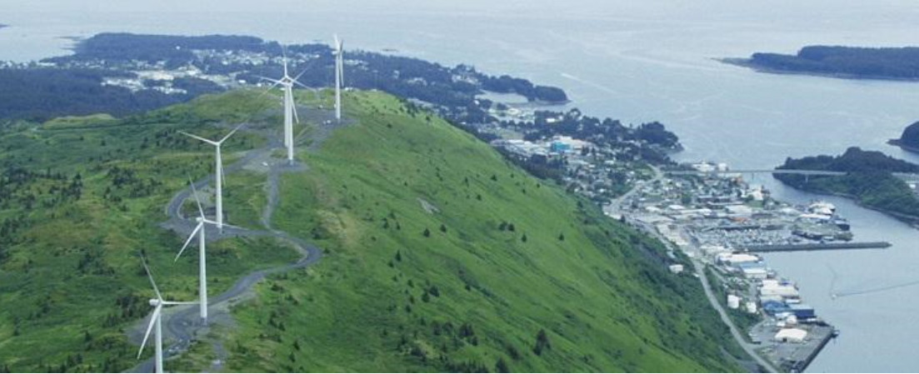
Utilities
Reduced installation time (-40%), maintenance costs (-50%) and outage time (-50%)
SELECTION
Asset performance management
Distributed energy resource management
Maintenance workflow management
Energy market trading system
Automated digital substation
Standard IP communications
Microgrids
Notes:
For example,
In Utilities,
Asset performance management lets us use digital simulations of transformers and other products to optimize maintenance schedules
By combining our recent investment in Enbala with our existing power grid software systems, we can integrate remote sources of energy generation, storage, and demand/response management into an integrated system.
We can use our maintenance workflow management systems to schedule the optimal downtime window to inspect and repair energy infrastructure.
Our energy market trading system is used by many liberalized energy markets to carry out the forecasts and trading of energy in the wholesale markets.
Our automated digital substation combines solid state power electronics with fiber-optic digital communications to reduce outage times.
We have a complete porfolio of wireless standard IP communications technologies that can enable use cases such as smart-metering and distribution automation.
Our microgrid solution contains all of the necessary hardware and software to act as a backup for the existing grid or to create completely autonomous grids in outlying areas.
These solutions deliver real customer benefits of up to 40% reduction in installation time, 50% less maintenance costs (thanks to predictive maintenance) and reduce outage times by half.

Slide 14
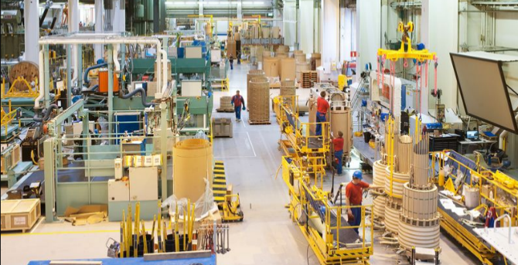
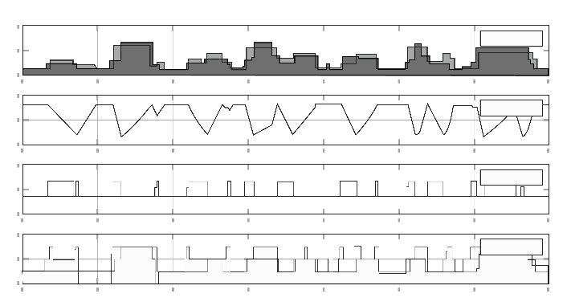
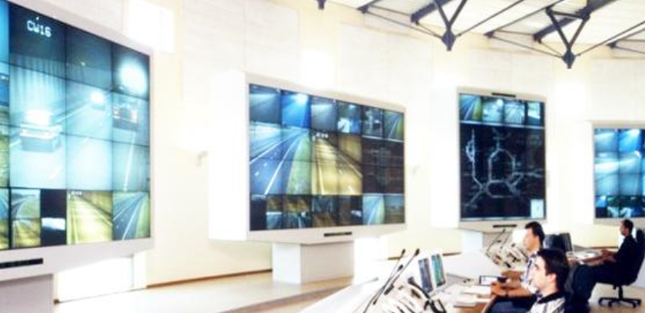
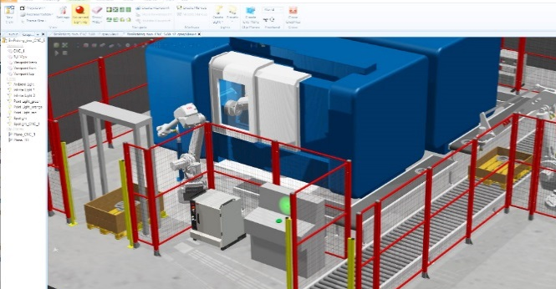
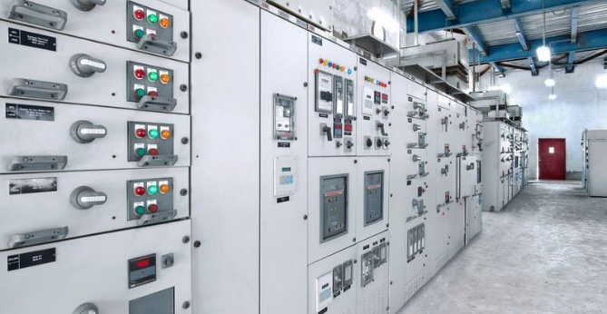
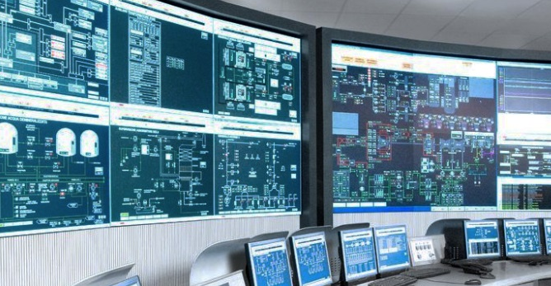
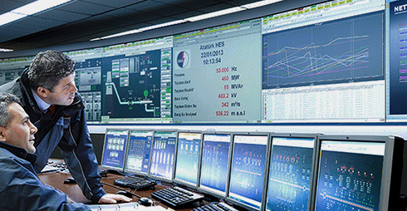
Industry
Improved productivity (+200%), reduced energy (-30%), & longer product life (+30%)
SELECTION
Connected robots
Manufacturing execution systems
Energy assessment
Cybersecurity assessment
Digital simulation for robot deployment
Power quality monitoring & demand-response
Distributed control systems
Remote monitoring & optimization
Notes:
In the discrete and process industries:
Our robots automate many tedious, dangerous, or difficult tasks
Our Manufacturing Execution System can schedule the production tasks in an entire plant
Our energy assessment services help customers identify where energy is being spent and how they can reduce overall consumption
Our cybersecurity assessments help to diagnose weaknesses in security in the plant
Our Robot Studio lets factory owners simulate the assembly line before deploying the robots
Our smart circuit breakers have additional software “apps” that can monitor the quality of incoming power and shed loads
Our distributed control systems (e.g. 800xA, Symphony+) provide the “brains” for automating entire processes
Our collaborative operations capabilities lets us remote monitor ships and oil rigs to optimize uptime
Our automation (robots & MES) have delivered improvements in productivity of 200% or more.
By using our intelligent drives and control systems, we can often reduce energy requirements by 30%
Via proactive continuous monitoring of our motors, we can extend their useful life by 30%

Slide 15


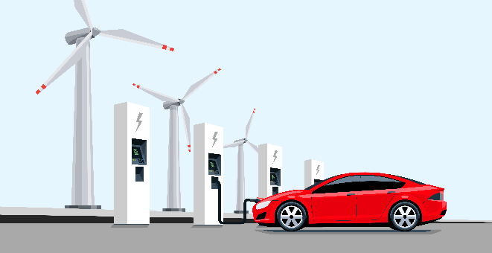
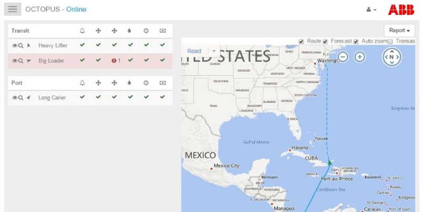
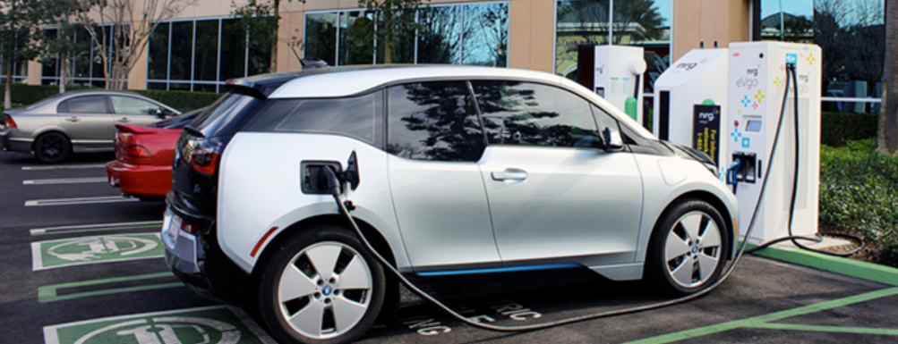
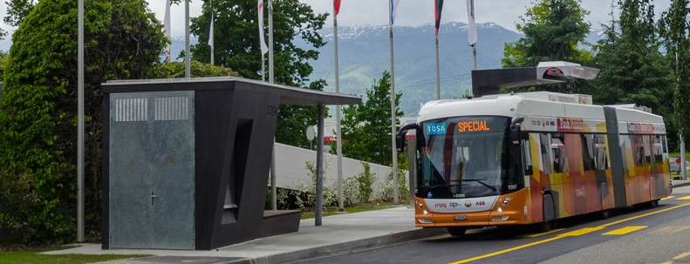
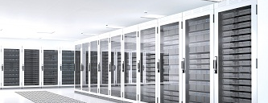
Transport & Infrastructure
Proactive detection of faults (90%), reduced maintenance costs (-20%) and energy costs (-5%)
SELECTION
Remote monitoring for ship electrical systems
Building automation
Vehicle-to-grid demand/supply coordination
Navigation optimization
for fleets
EV charging with cloud management
Flash-charging electric buses
Energy management for mega-datacenters
Notes:
In Transport & Infrastructure:
We can remotely monitor ships and provide proactive alerts to their crews and owners
We provide smart building systems to optimize HVAC and other systems
We are creating the ability to leverage connected vehicle charging systems to help with peak-shaving on the grid
We have software that can optimize the routes of ships based on weather conditions
Our EV charging systems can be remote monitored and provide billing and usage reports
Our flash charging bus systems will increasingly be linked to the grid for “grid-aware” charging (each bus charging system consumes as much power as 200 homes)!
As the cloud expands we are seeing new datacenters require as much as 1GW of power! This is as much as a small city. We provide the electrical and software systems to manage power transformers, generation, storage for these large scale datacenters.
With remote monitoring, we can often detect up to 90% of problems as they arise. We can reduce maintenance costs by 20% and save energy by 5% in shipping and other transportation sectors.

Slide 16
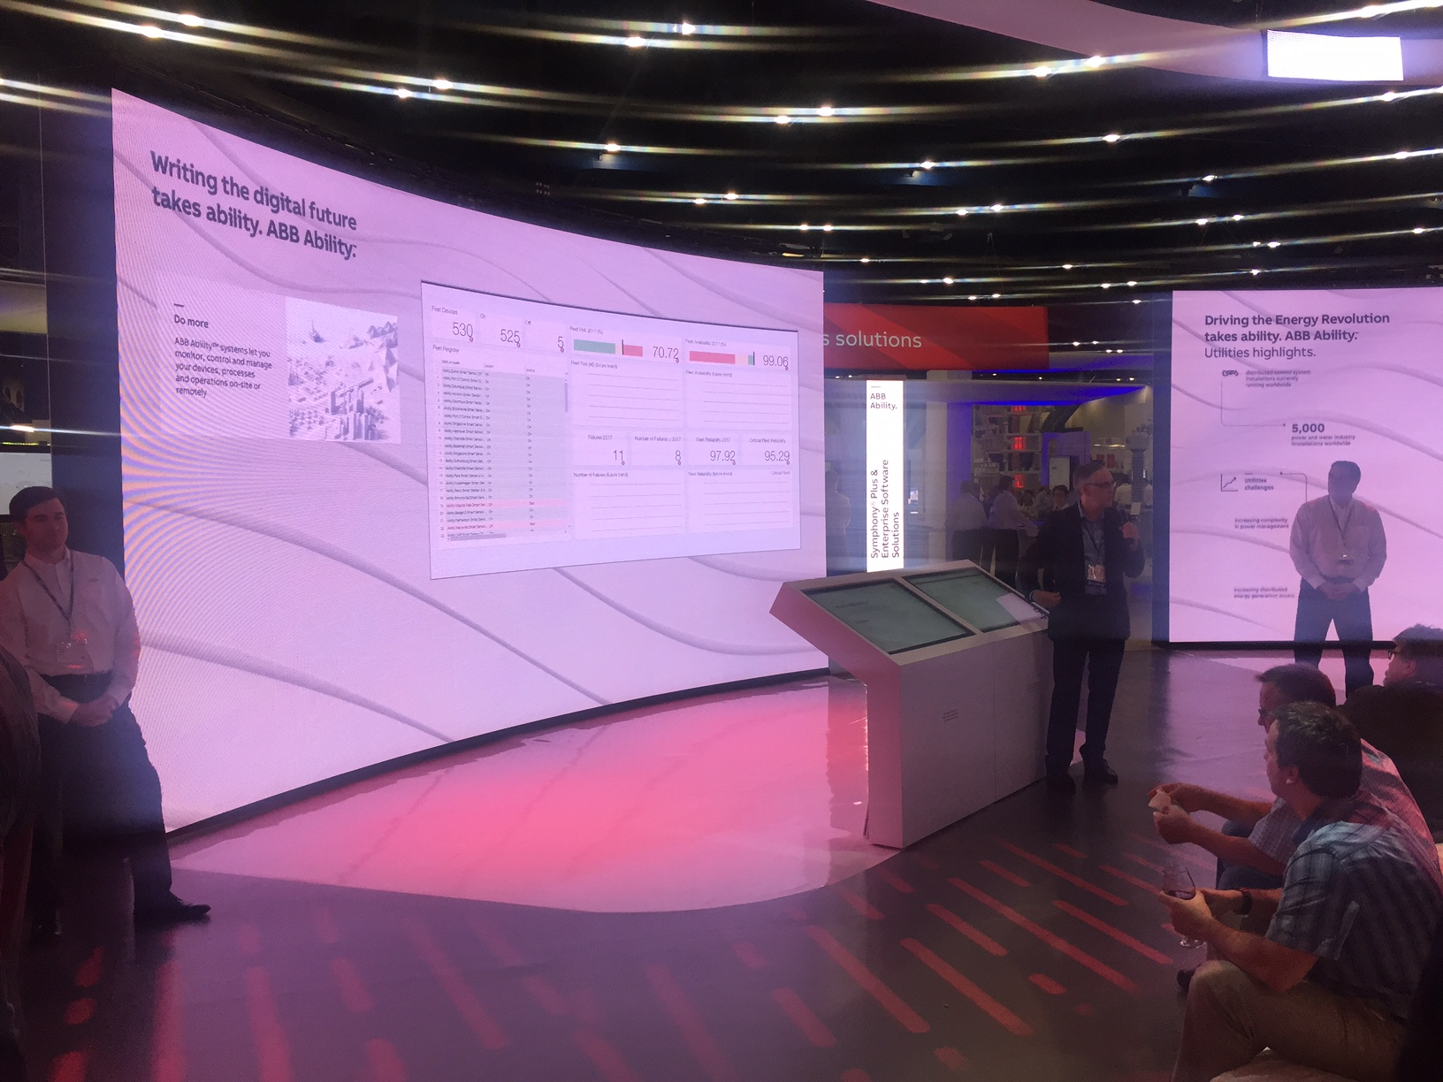
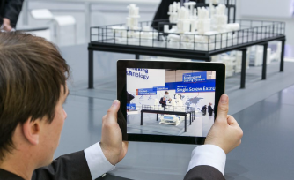
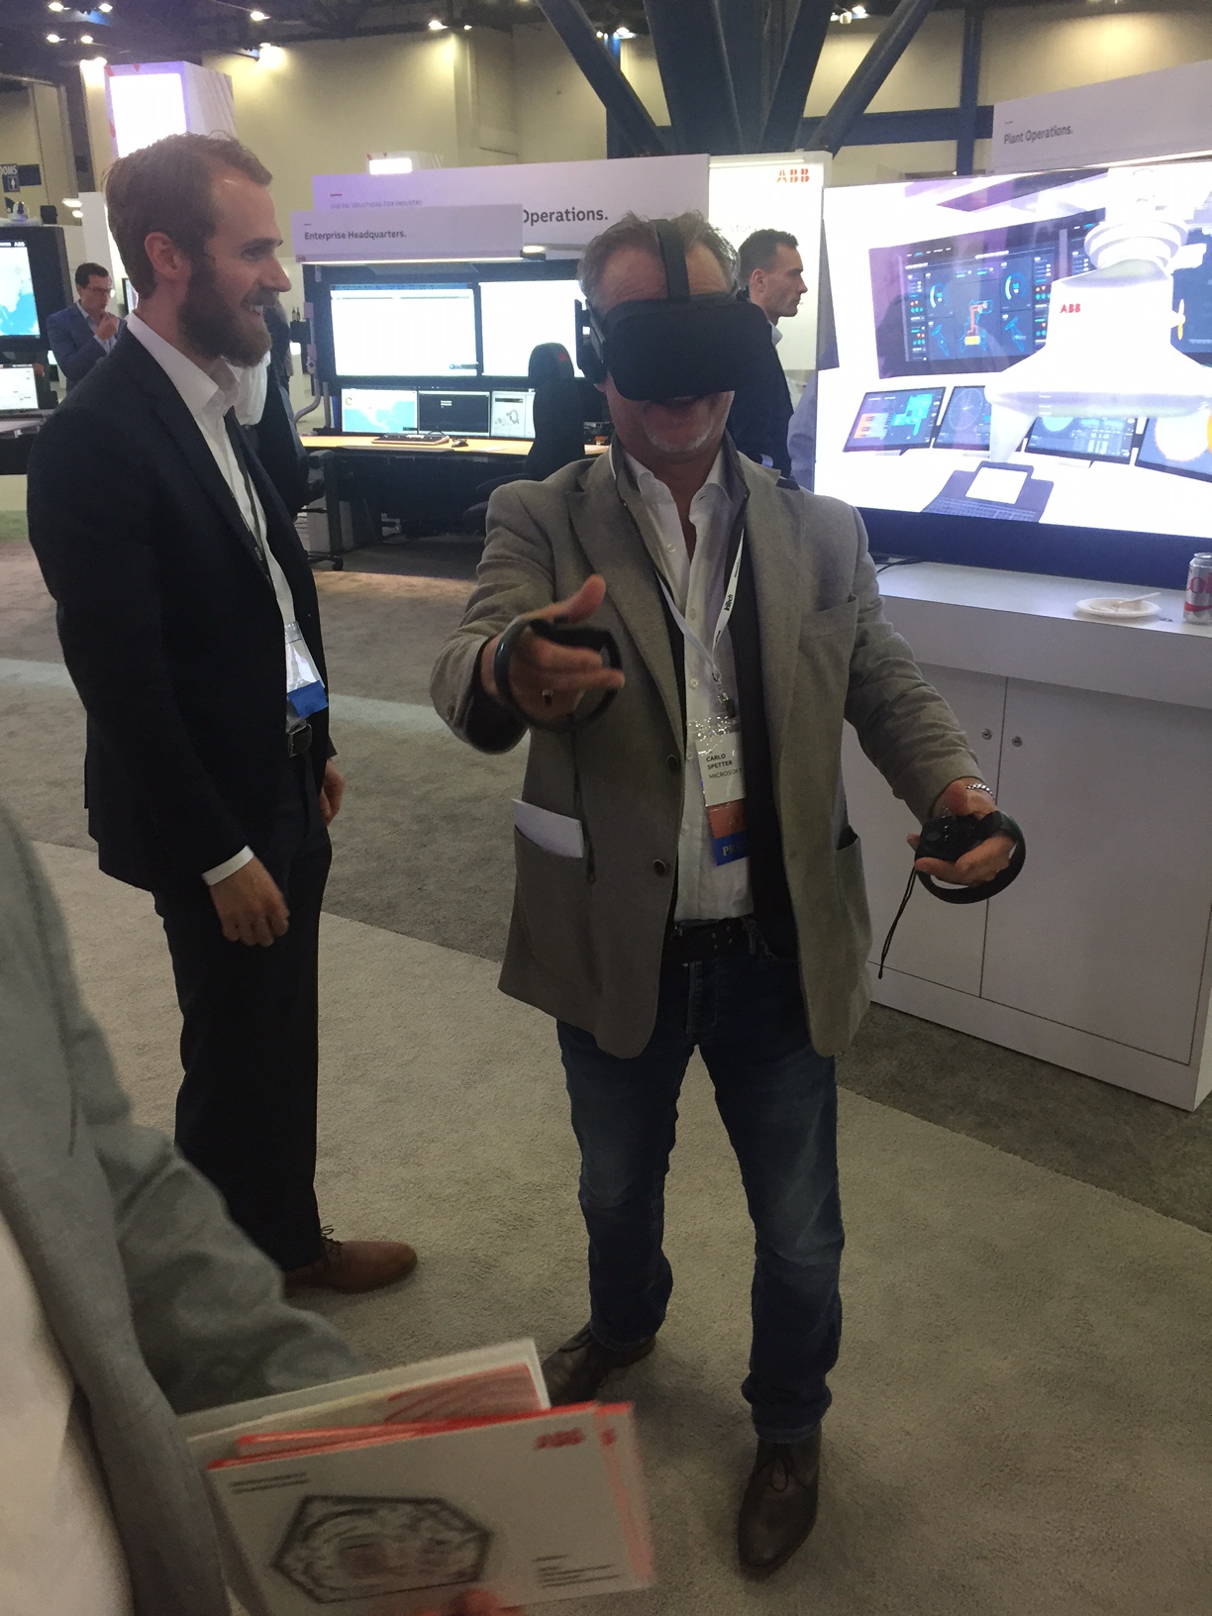
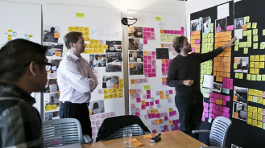
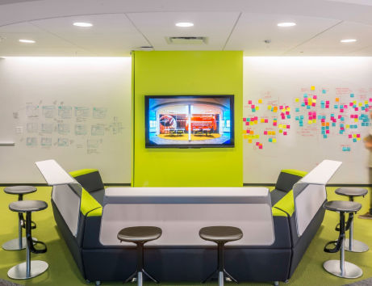
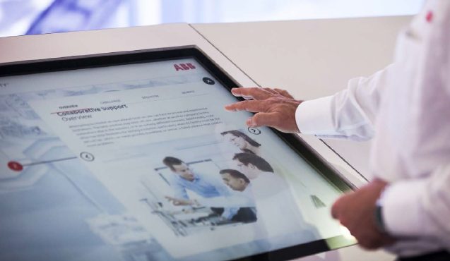
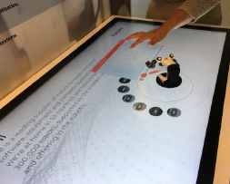
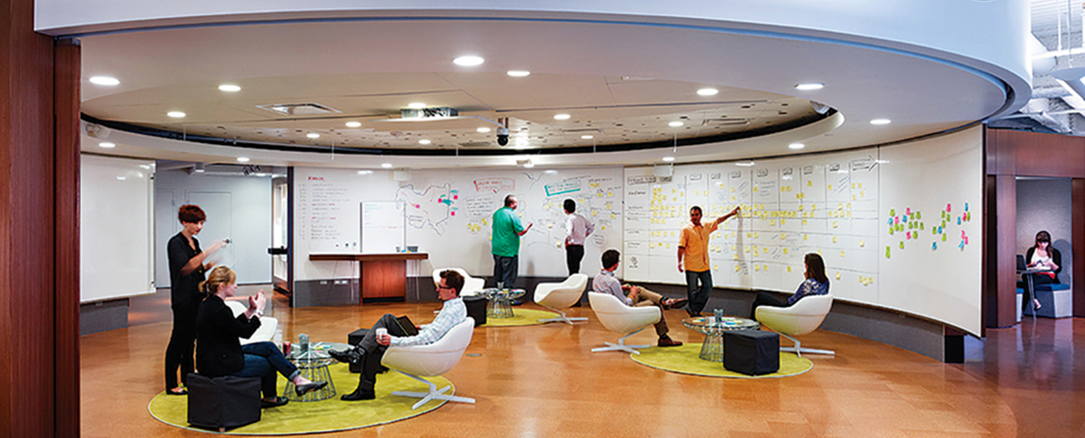
ABB Ability Customer Experience (ACE) Centers
Co-creating Digitalization Value with Customers. Accelerating Sales.
Immersive & Flexible ABB Ability Solution Experience
ABB Branded Co-creation with Customer Process

Slide 17
ABB Ability Customer Experience (ACE) Centers
Starting with one ACE Center per Region (Ladenburg – Houston – Bangalore). Winning Together
EUR
Ladenburg
Germany
AMER
Houston
TX USA
AMEA
Bangalore
India
ACE Center
Other ABB Customer Center

Slide 18
Innovation takes ability. ABB Ability™
Over a hundred solutions available now
180 + ABB Ability™ solutions
Utilities
Industry
Transport & Infrastructure
Notes:
While ABB Ability™ may sound futuristic, it’s here today.
We have over 180 different solutions available and being deployed by customers across a wide range of industries.

Slide 19
Agenda
The digital revolution – coming now to industrial markets
ABB Ability™
Conclusions
Notes:
In this presentation, we will cover how technology innovations are primed to transform the industrial markets that ABB serves.
We’ll also discuss what is required to win in the digital arena and how ABB is well positioned.
We have a wide range of industry-leading solutions today, which will increasingly be developed on a common technology platform.
This platform is a set of re-usable technical components and will allow our solutions to be deployed on premise, in the cloud, and between clouds
And this is not a statement about the future — it is about solutions that customers are deploying today.

Slide 20
Conclusions
1
Digital opportunity is here
2
Digital is transforming every aspect of industry
3
Need to combine IT innovations with Operational Technology expertise
4
ABB has a wide range of industry-leading solutions
5
Industry-standard platform components leverage an ecosystem of innovation
6
ABB has unparalleled expertise in technology, information, and domain know-how
7
ABB Ability™ solutions are ready now
Notes:
In conclusion,
The digital opportunity is here today.
The technology innovations that have been transforming our lives as consumers since the beginning of this century are now being applied to the industrial space.
This creates an unprecedented opportunity to capture value as entire industries are transformed. To do this, we need to combine information technology (IT) with operational technology (OT) know-how.
ABB is combining the best of IT with OT to offer a wide range of industry solutions that customers are benefiting from today.
By building these solutions on an industry-standard technologies (Azure, etc.), customers can leverage an entire ecosystem of developers that bring their own innovations.
ABB has 125 years of experience in solving customer problems. Specifically we offer a unique ability to ”close the loop” via automation: to sense + analyze + act.
Contact your sales person and find out how we can help.
Thank you.

Slide 21


















Unlocking Customer Value through Digitalization
Let’s win together!
Writing the digital future takes ability.
ABB Ability™.

