Slide 1


Value beyond illumination
Communication and data through
connected lighting
Silviu Bulzan, Key Account Manager Office & Industry CEE Philips Lighting

Slide 2
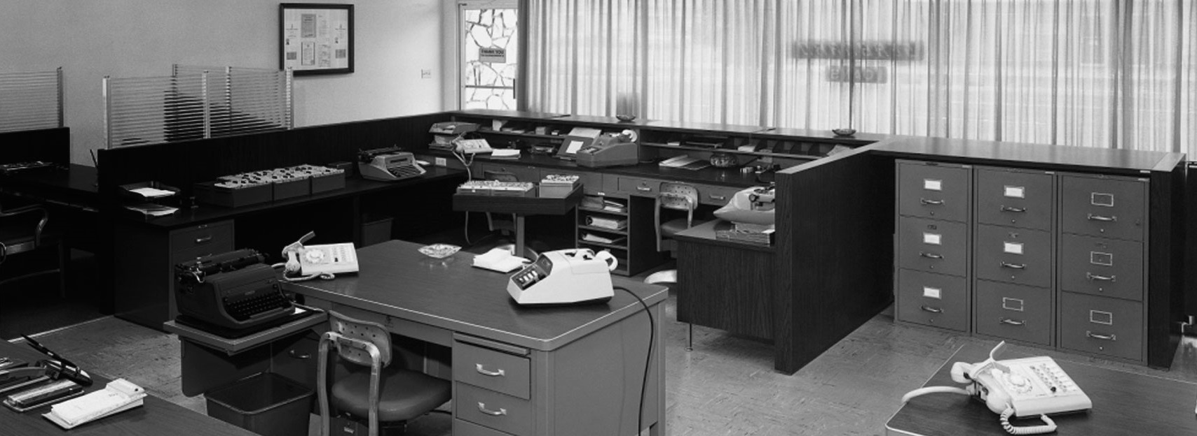
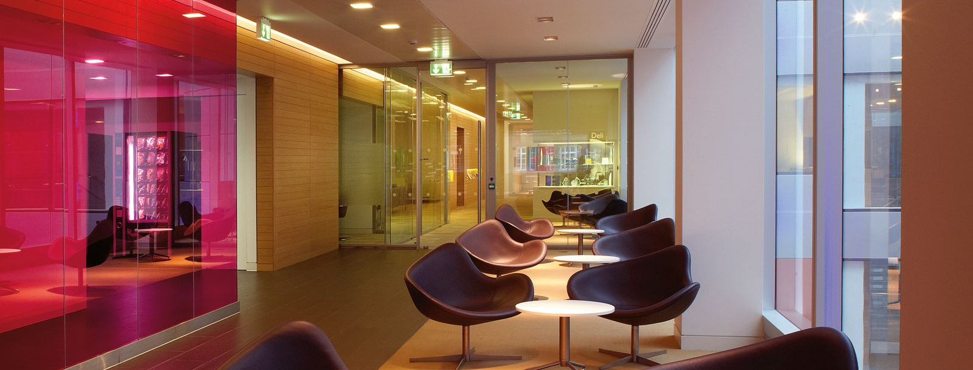
THE EVOLUTION OF OFFICE LIGHTING

Slide 3

THE WORLD IS FLAT
Globalization 3.0
Thomas L. Friedman

Slide 4

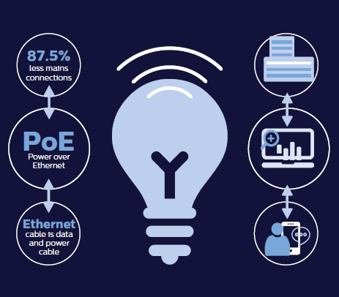
Market context
In the Internet of Things (IoT), it’s all about the data.
Connected devices are connected expressly for the purpose of gathering and sharing information about themselves, about the environment in which they’re used, and about the people who use them. In a connected lighting system, luminaires and other lighting system devices merge with IT networks to allow for the collection, distribution, and storage of large amounts of data.

Slide 5
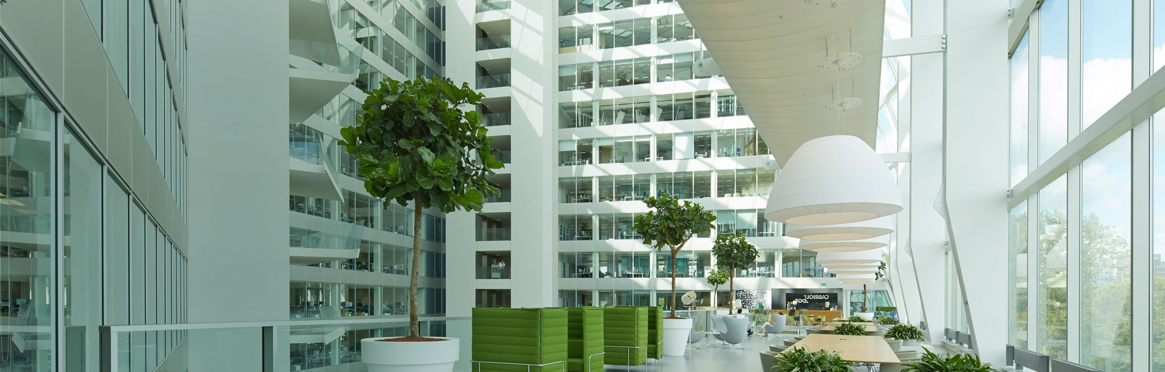

Connected Lighting Benefits
Owners of the space
Demonstration of the Thought Leadership and Sustainability commitment
Unique business value delivered to Tenant
PR leverage for company through demonstration of unique innovation and demonstration of values
Tenant attraction through tailored Marketing activities
Impact on asset value in future transaction/s
Increased Building Management performance through data mining, data history and business analytics feeding Continuous Improvement Process to optimize the OPEX and keep/increase Tenant satisfaction
Capex investment difference vs „classic school“– capex increase for system leveraged with reduction of capex in infrastructure
Future proof: system is flexible, upgradable, updatable
Reduced time for Solution Execution: safer and easier to install

Slide 6
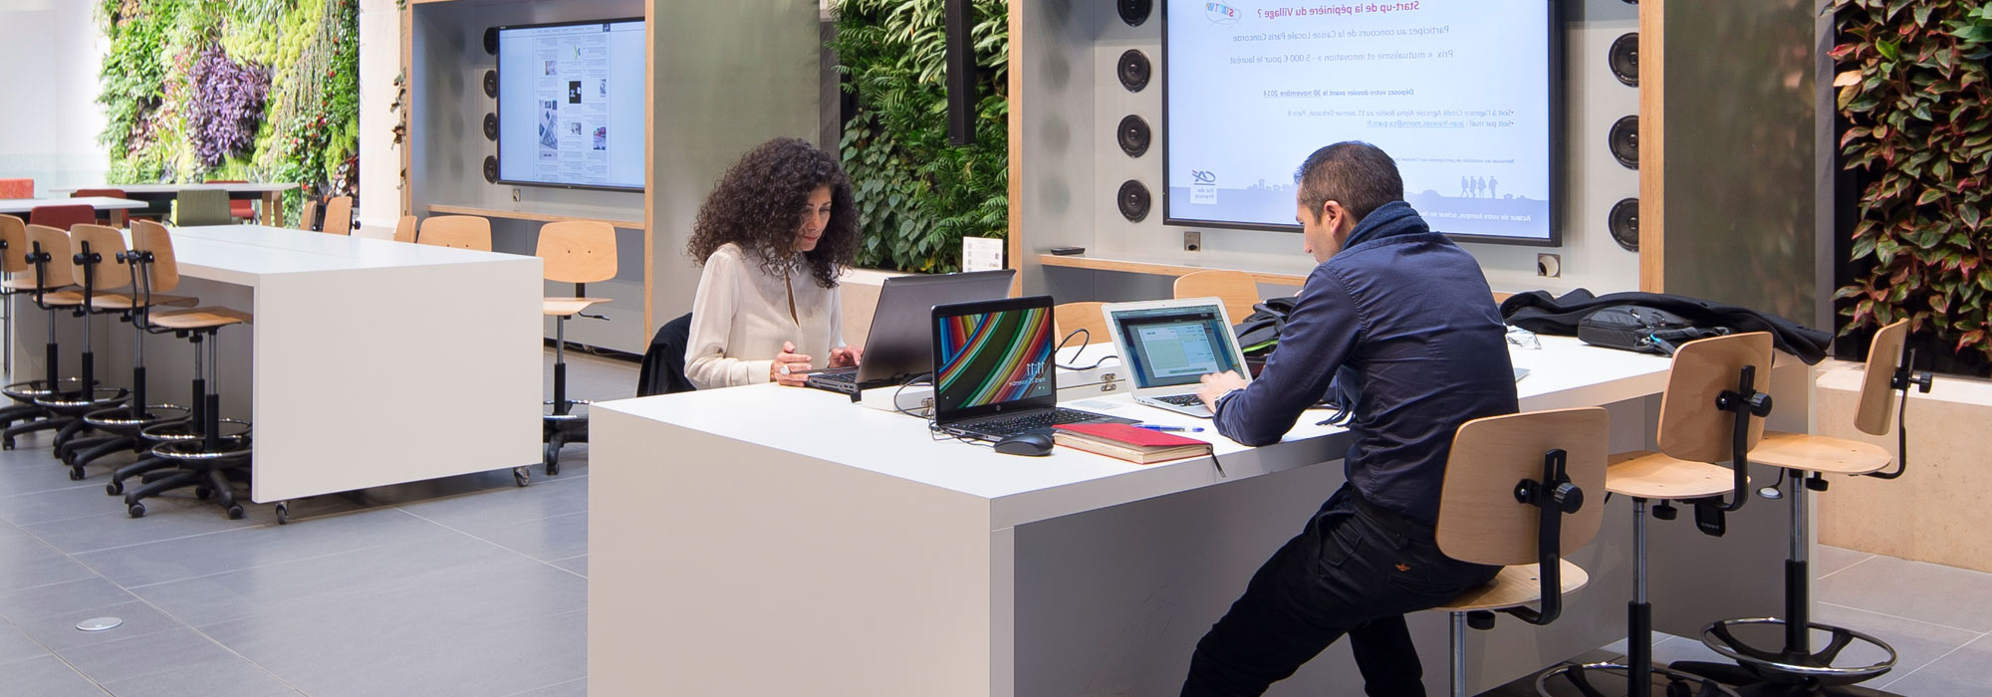

Connected Lighting Benefits
Tenants & Employees (users of the space)
Personalized employee’s experience and satisfaction
Control of employee of his „private space“
Well-being, comfort
Contribution to company business performance through workforce engagement, creativity and innovation
Talent attraction and retention
Intelligence through business analytics of company „heartbeat“
Improved workspace utilization through business analytics intelligence (live data feed fueling Continuous Improvement Process)
Fast and simple adaptation to new business model / organizational set-up
From value beyond illumination brings to OPEX optimization beyond energy

Slide 7
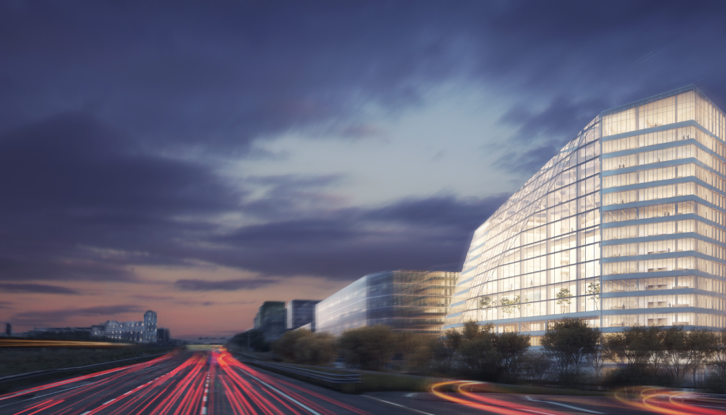
The New Office Experience
The Edge Building, Amsterdam
The most innovative and sustainable building in the world
Connected Lighting:
Over 6,000 LED luminaires, integrated within the IT network of the building
The LEDs save energy, because they offer 300 Lux, instead of the standard 500 Lux. As a result 3.9 Watts/m² is used instead of the usual 8 Watts/m²
Every second luminaire is equipped with a multi-sensor measuring movement, light, temperature & infrared
Dashboard of real time and historical data & analytics about the building usage
Employees act as owners & operators of their working space

Slide 8
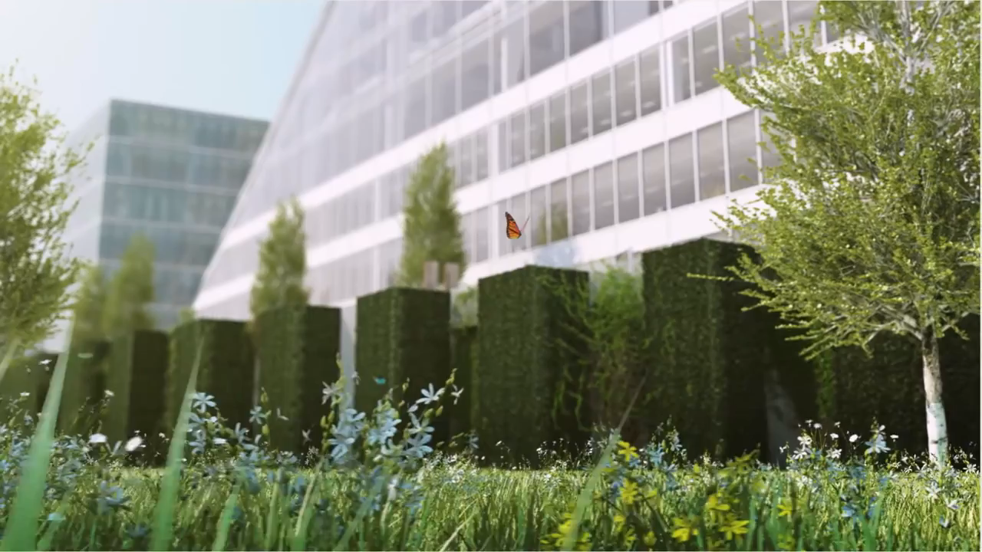
THE EDGE BUILDING – Find Out More

Slide 9
