Slide 2
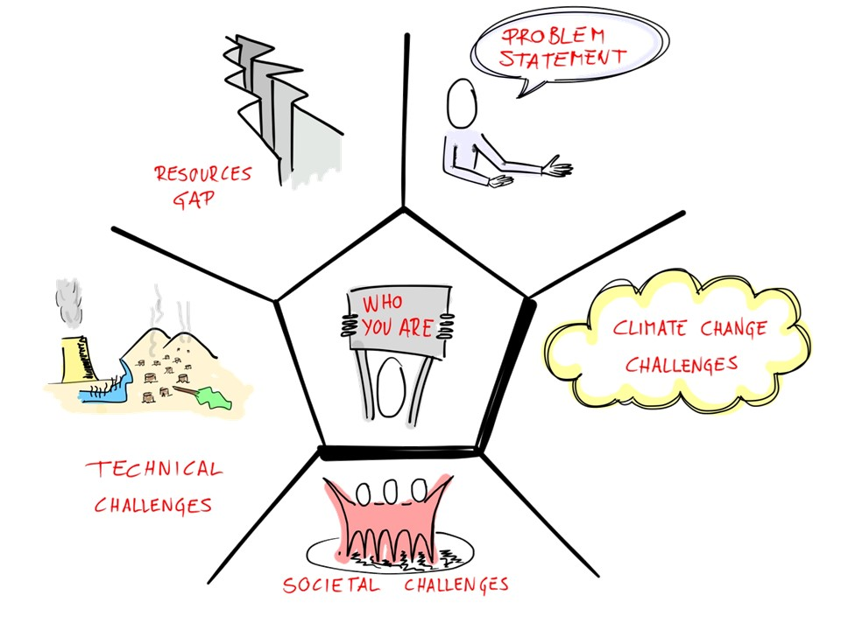
https://vimeo.com/162815698

Slide 3
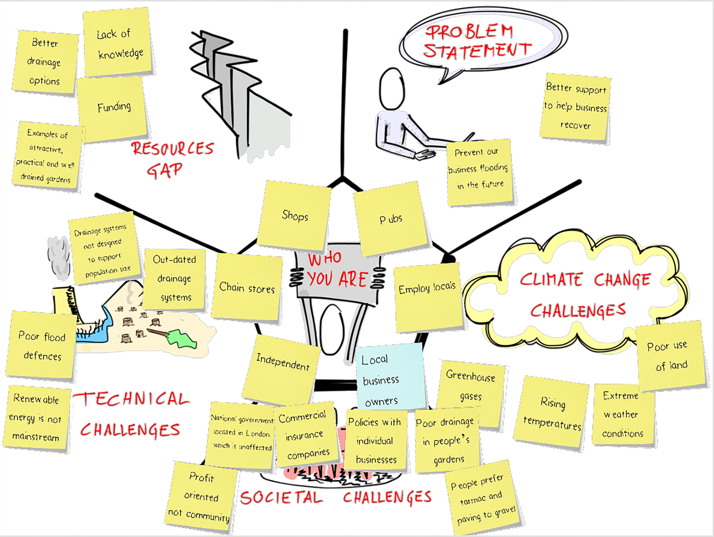

Slide 9
P118/1-2017
P118-99

Slide 14
www.oar.archi

