Slide 1
Liberalization in energy sector
Trends and benefits

Slide 2
SAS Institute
360° POWER FOR AN INTEGRATED COMPANY MANAGEMENT
Customer around the globe trust SAS at more than 65.000 locations – 91 of Top100 FORTUNE Global 500® companies– trust SAS solutions
Constant Revenue increase 1976-2014
Largest privately held software company
Founded 1976 in Cary, North Carolina
13.000 employees worldwide
Since 2002 represented in Romania
Great Place to Work
International TURNOVER
3,02 Mrd. US$
Investition in R&D 25 %
1976
1980
1985
1990
1995
2000
2005
2012
SUCCESS
Analysts views
Value generated continuously

Slide 3
We want to be the first company people call when they need to solve business problems.
SAS has everything it takes to achieve this: unmatched analytical capabilities, deep industry expertise, a long track record of delivering proven results, and the ability to innovate.
- Jim Goodnight, CEO of SAS
Notes:
Talking Points
Harnessing data to support competitive decision making can make a difference to the bottom line and the top line of your business.
It’s not about technology. It’s about solving business problems—specifically solving problems you face in your own industry.
To quote another visionary, our CEO Jim Goodnight, SAS wants to be the first company people call when they need to solve business problems. It’s a straightforward goal that we’ve been building on since 1976.
Today SAS is the leader in business analytics software and services. We help customers at more than 50,000 business, government and university sites improve performance and deliver value by making better decisions faster.
Our customers call on SAS for answers. We respond by delivering unmatched analytics…a deep understanding of their industries….the ability to innovate…

Slide 4
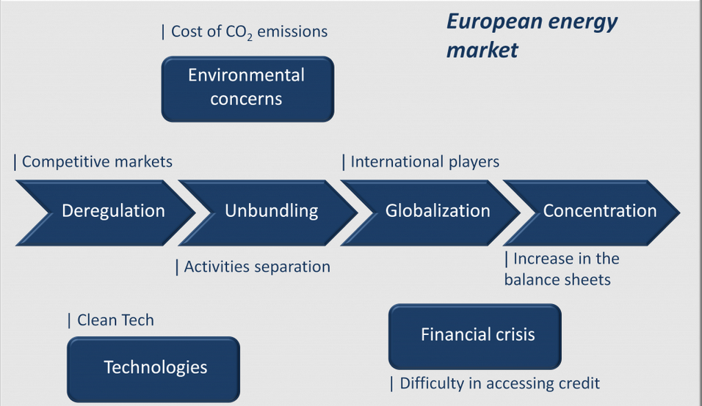
LIBERALIZAtion
Problem definition
The liberalization of the energy market in Romania means:
the separation of the main activities of generation, transport, distribution and supply (UNBUNDLING)
the government’s release of the price control (DEREGULATION).

Slide 5
Energy liberalization
At a glance
ENERGY LIBERALIZATION
NEW PLAYERS
NEW PROCESS
NEW BUSINESS
NEW RULES
REDUCE PRICE
INCREASE EFFICIENCY

Slide 6
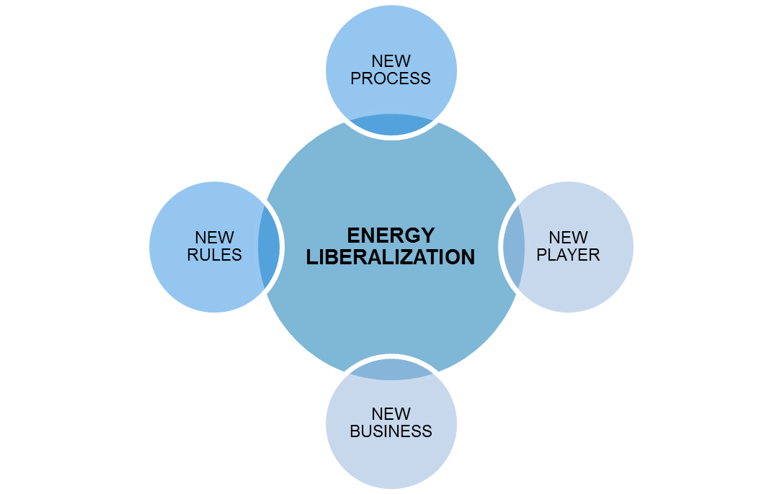
Energy liberalization
New rules
Network Code
Continuously fine tuning
…
Renewable Energy
EU Globalization
Single electrictity market

Slide 7
Energy liberalization
New players
Regulated Operators
GenCo
TransCo
MetCo
DisCo
Market Operators
TradCo
RetCo
Prosumers

Slide 8
Energy liberalization
New processes
Comunication
between operator
With National Regulatory Agency
With customers
Marketing
Trading
Concentration / Globalization / Accountability
Credit Management

Slide 9
Energy liberalization
New BUSINESS
REGULATED OPERATORS
Reduce Operation and Asset Costs
Manage Uncertain and limited visibility
Fraud Management
Smart Grid and Renewable Energy
Sell Value Added Services
MARKET OPERATORS
Market penetration
Competitive Analysis
Customer Management
Recenue Assurance

Slide 10
Energy liberalization
New BUSINESS
REGULATED OPERATORS
Reduce Operation and Asset Costs
Manage Uncertain and limited visibility
Fraud Managent
Smart Grid and Renewable Energy
Sell Value Added Services
MARKET OPERATORS
Market penetration
Competitive Analysis
Customer Management
Recenue Assurance
Consumer-based analytics
Risk Management
Situational awareness gained through sensor reporting the health of the equipment on an ongoing basis
Grid optimization analytics of the transmission & distribution networks

Slide 11
Transforming utilities
Solutions across utilities value chain
G
T
D
R
Energy Portfolio Management Load Forecasting, Portfolio Optimization, Energy Trading & Risk Management
Asset/Network Optimization & Analytics Predictive Asset Maintenance, Distribution Optimization
Customer Intelligence Revenue Assurance, Segmentation, DR Sales Program Optimization
Smart Grid Data Management High Performance Computing, Master Data Management, Data Integration/Quality
Notes:
Energy Portfolio Optimization - A category of solutions, analytical tools and optimization applications to help Utilities perform short, mid and long term energy planning and operations.
Network Optimization and Analytics - A category of optimization and analytical applications to be deployed across Distribution Management Systems (DMS), Energy Management Systems (EMS), and ERP systems to make the transmission and distribution systems operate most efficiently.
Customer Intelligence - A set of solutions that analyze patterns of customer behavior to enable a utility to improve interactions, reduce bad debt, and optimize marketing campaigns.
Smart Grid Data Management - The IT infrastructure necessary to meet the requirements of Utilities facing the challenges of high data volumes.

Slide 12
SAS UTILITIES
Analytic AREAS of Focus
Energy Forecasting
Renewables Forecasting
Net Metering / DG
Energy Efficiency Analytics
Portfolio Optimization
Trade Risk Management
Operations
Revenue Assurance
Billing and Usage Analytics
Cybersecurity
Work Order and Resource Optimization
Premise Intelligence
SAS Energy Forecasting
SAS Visual Analytics
SAS Optimization
SAS Fraud Framework
SAS Visual Analytics
Portfolio
The Connected Utility
DATA MANAGEMENT
Assets
DATA MANAGEMENT
Behavioral Analytics
Social & Sentiment Analytics
Channel Optimization
Program / Product Design
Premise Intelligence
SAS Asset Performance Analytics
SAS Work Force Optimization
SAS Visual Analytics
SAS Customer Intelligence
SAS Marketing Optimization
SAS Social Media Analytics
Reliability Management
Cost Performance Analytics
Fleet and Asset Performance
Predictive Maintenance
Customers
ENABLEMENT: IN-DATABASE HADOOP GRID ESP IN-MEMORY CLOUD

Slide 13
Endesa: A Global dual power operator
Core business: energy
Presence in 10 countries
Installed capacity: 39 GW
Output: 147 TWh
Customers: 24 million
Employees: 27 thousand
No.1 in Spanish electricity sector
No. 2 in Spanish gas sector
Leading private electric utility in Latin America
Present throughout the entire electricity and natural gas value chain
Note: YE08 proforma figures (considering asset disposals to Acciona and including ESB)

Slide 14
Commercial Strategy of Endesa since 1999
Based upon
three basic pillars
Excellent Customer Service
Leadership in the Liberalization Process of Electricity & Gas Markets
Developementof Value from our Customer Base

Slide 15
This strategy has been implemented both through our customers and from our network of Points of Service
Finance
Electricity
Electricity Maintenance
ENERGY
+
MAINTENANACE
+
ALLIANCES
Gas
Insurances
Gas Maintenance
Right to the Customer
Home repairs
Endesa has a unique structure, with almost 500 “Points of Service” all around Spain
ENERGY EQUIPMENT
+
Through the Channel
OTHER PRODUCTS

Slide 16
Endesa’s experience in Customer Intelligence
1999 First datamart and datamining team
2000 First project with SAS Institute
2001 First segmentation and customer behaviour model using SAS Miner as an Analytics tool
2004 Endesa among the three companies nominated for the “best Spanish company in Business Intelligence”
2005-2006 Participation in the “Santo Mauro Forum” with other leader companies (to share and develope knowledge in “advanced customer management”)
2000 - 2010 Participation in C.I. Forums in Madrid, London, Florencia, Amsterdam, Bratislava…

Slide 17
But the process was not an easy trip
1997 (Creation of the Commercial Area)
Present Situation
Electricity Market Opens
7 Different Commercial Systems
No Marketing Databases or tools
Without specialists in Information Analysis
Datamining … what’s that? Who needs “miners” for Marketing?
Gas Market also opens
Only a few gas customers
Very low Marketing budget
C.I. Departments in Mass Market, Medium Companies and Large Customer Segments
Operational CRM Project
Campaigns Management
Marketing Datamarts, integrated with other internal and external Databases
Integration of Market Research and campaigns results
Much higher productivity
Continuous improvement of data quality
Multiple segmentations, analysis,…

Slide 18
Key learnings in our process
We started with a small segmentation project, with an obsolete computer and a ridiculous budget
So, the ROI and results were outstanding and it made easier the next step ahead
Start with something simple
Grow slowly at the beginning and demonstrate results before next step
Now we can provide information, projections, etc, in much less time and with lower costs (not only $) than before
Focus on data quality, and integration of information
Finally, we obtained a competitive advantage in the market: C.I.
Convince high management (Marketing, Financial, Procurement,…)
Not neccessariy on the base of a business plan, but…
When we proposed the acquisition of SAS tools, we showed what we were doing, what we could do, and the advantage upon our competitors and savings in costs it would provide
It’s neccessary to count both with skilled analysts and data experts, as well as the commitment of different areas such as Marketing, Sales, Systems, Operations, etc.
We started in the Mass Market, but it is not a must
Commited people
Year

Slide 19
Some history of C.I. in Endesa: “Roadmap”
Start up
(1998)
Demonstrate and consolidate
(2000 – 2005)
Innovative growth
(from 2006)
First, the first: integrate data in a unique repository
Implement basic data tools (not necessarily SAS)
Data cleaning, and data quality (know what you have and what you need)
Complete with external data and market research
Have at least one analyst and one data expert
Create Dashboard
Results, results, results,…
Launch a small and easy project
Implement Datamart and basic Datamining tools (SAS Miner,…)
Implement internal C.I. team
Analytics CRM Project
Apply analitics to:
Basic (Descriptive) segmentation
Behaviour patterns
Customer scoring
Marketing campaigns
Churn analysis
Customer value
New Segmentations, GIS Analysis
New Algorithms applied to campaigns
Results, results, results,…
New Value Segmentation
Campaigns Management
GIS Development
Datamart Development
Campaigns Prioritization
Increase depth of analysis and goals: Retention models, Churn models, Loyalty models
Results, results, results,…
Year

Slide 20
Thank you

