Slide 1

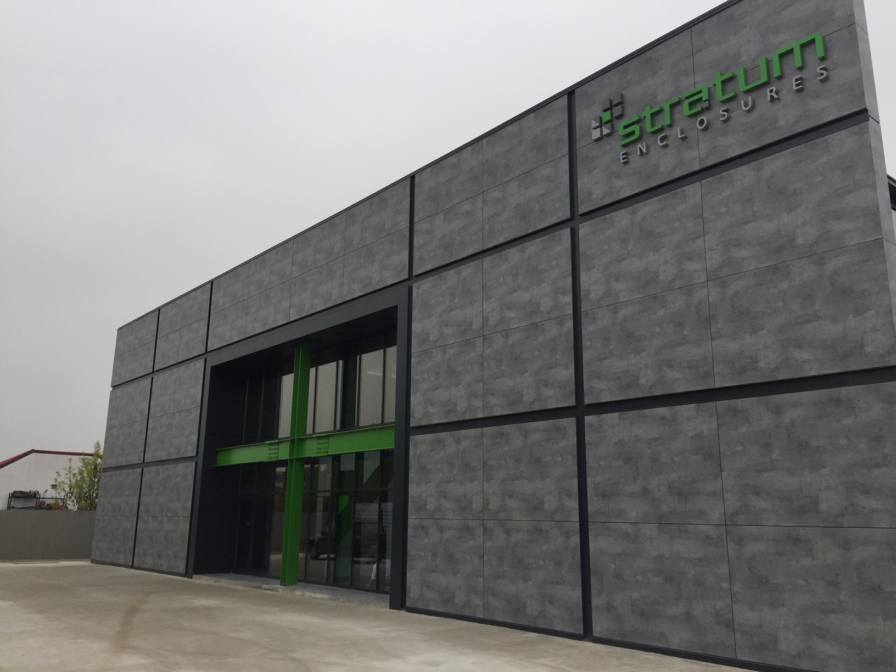

Company
Profile

Slide 2
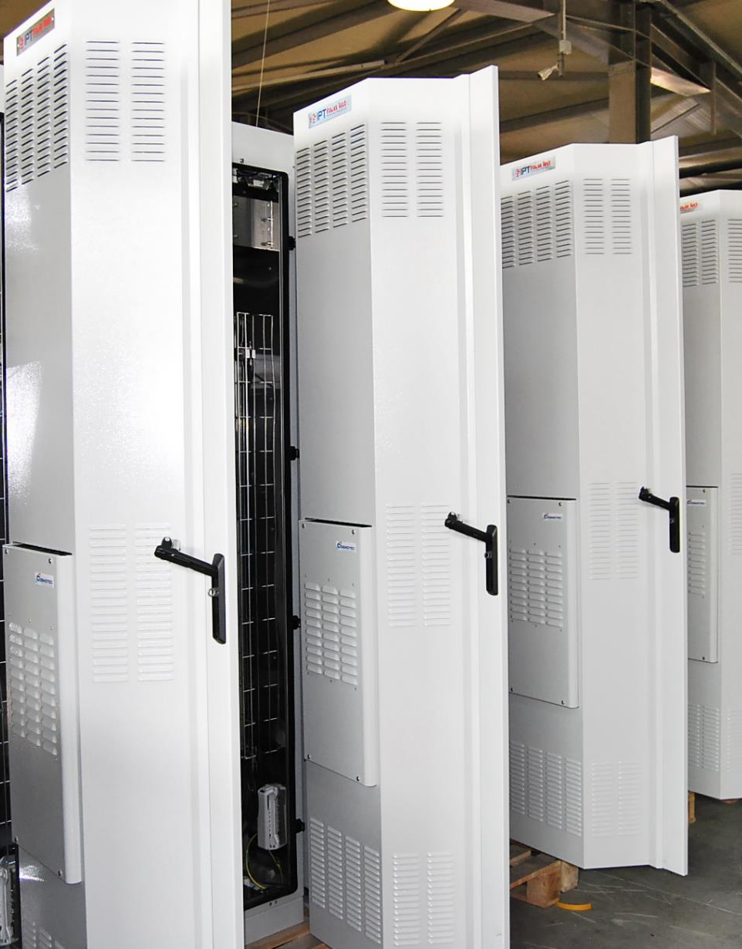
Who we are
Stratum Enclosures, is the Leading ODM enclosures manufacturer and integrator of cabinets for the Telecom sector, power solutions, Energy storage and data centers.
Acquired and Modernized by IPI Group Holding in 2011, the Romanian Enclosure Manufacturing facility takes pride in its international ISO certifications and in its dedicated team exceeding the 120 professionals and delivering the most versatile projects in Europe, Middle East, Africa and South East Asia.
More than 4000 employees within the group.

Slide 3



Our Strategical Sectors
Telecom Sector
Data Centers
Infrastructures
Industrial
Renewable Energy
Railways

Slide 4
Our Factory
State of the art production facility

Slide 5

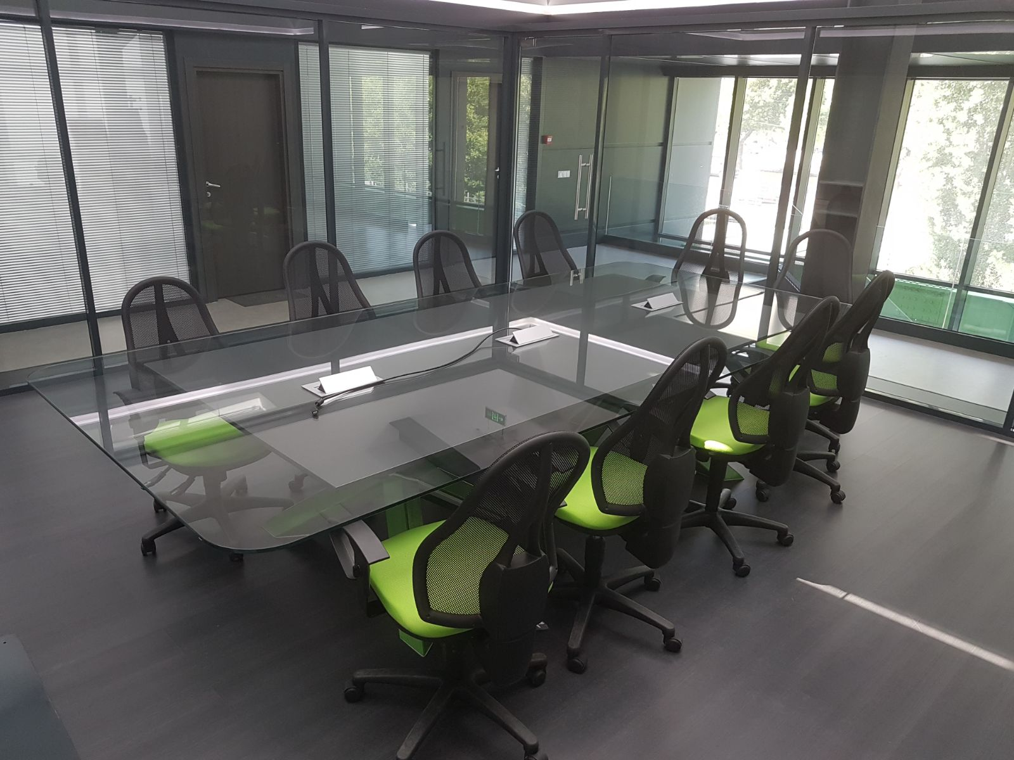
Our Organizational Structure
•Design Department
•Production Department
•Customer Care Department
•After-Sales Department
•Technical Support

Slide 6

20-20-20 targets
The climate and energy package is a set of binding legislation which aims to ensure the European Union meets its ambitious climate and energy targets for 2020.
In STRATUM ENCLOSURES factory we are promoting "GREEN" and we achieve a part of the objective sets
- 51.09% from the energy used in the Manufacturing Process of STRATUM ENCLOSURES comes from renewable energy production(Wind turbines)
These targets, known as the "20-20-20" targets, set three key objectives for 2020:
A 20% reduction in EU greenhouse gas emissions from 1990 levels;
Raising the share of EU energy consumption produced from renewable resources to 20%;
A 20% improvement in the EU's energy efficiency.

Slide 7
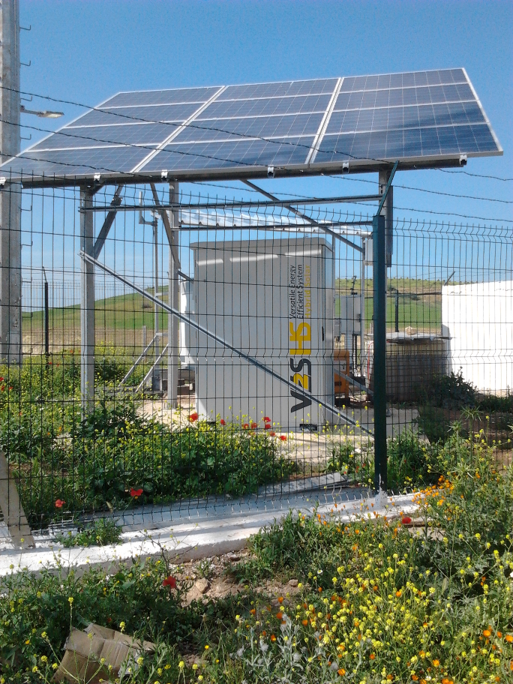
Our Projects
Energy storage

Slide 8
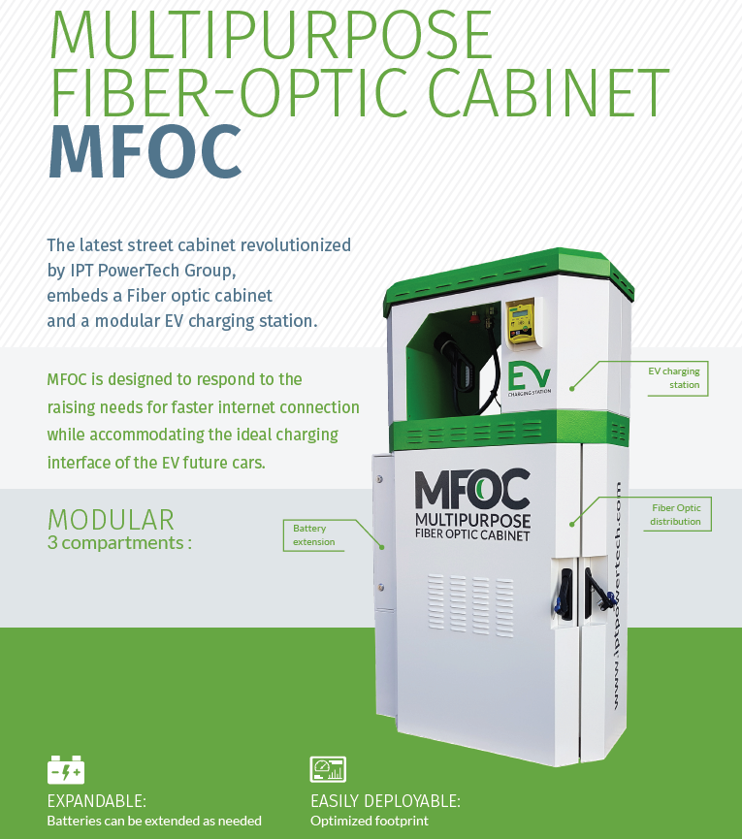
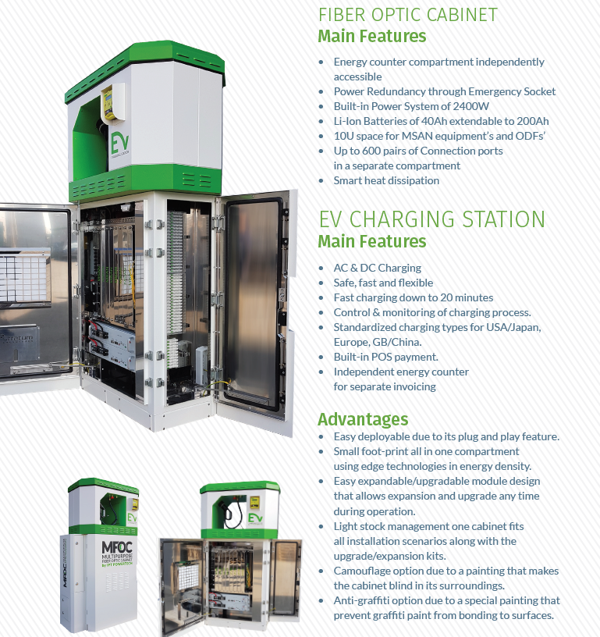

Slide 9
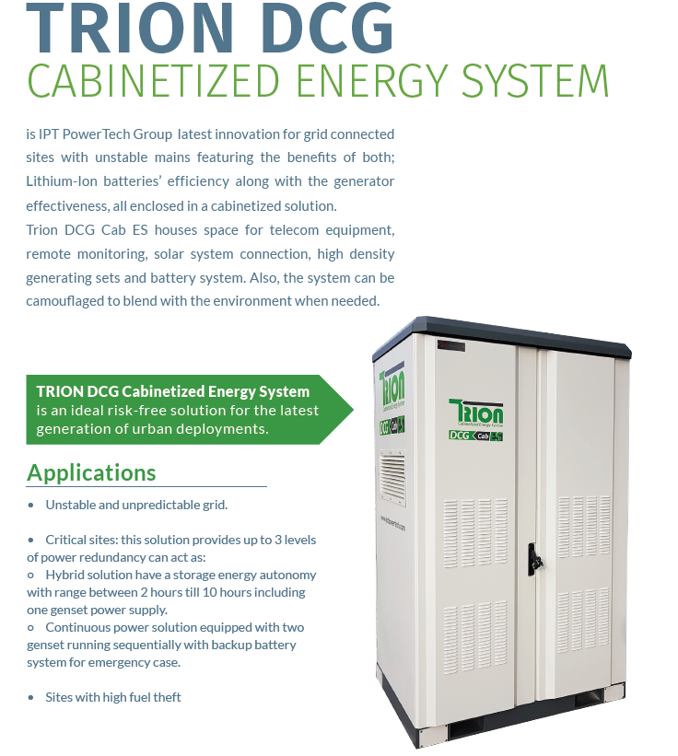

Slide 10

EV-Charging AC CHARGING

Slide 11
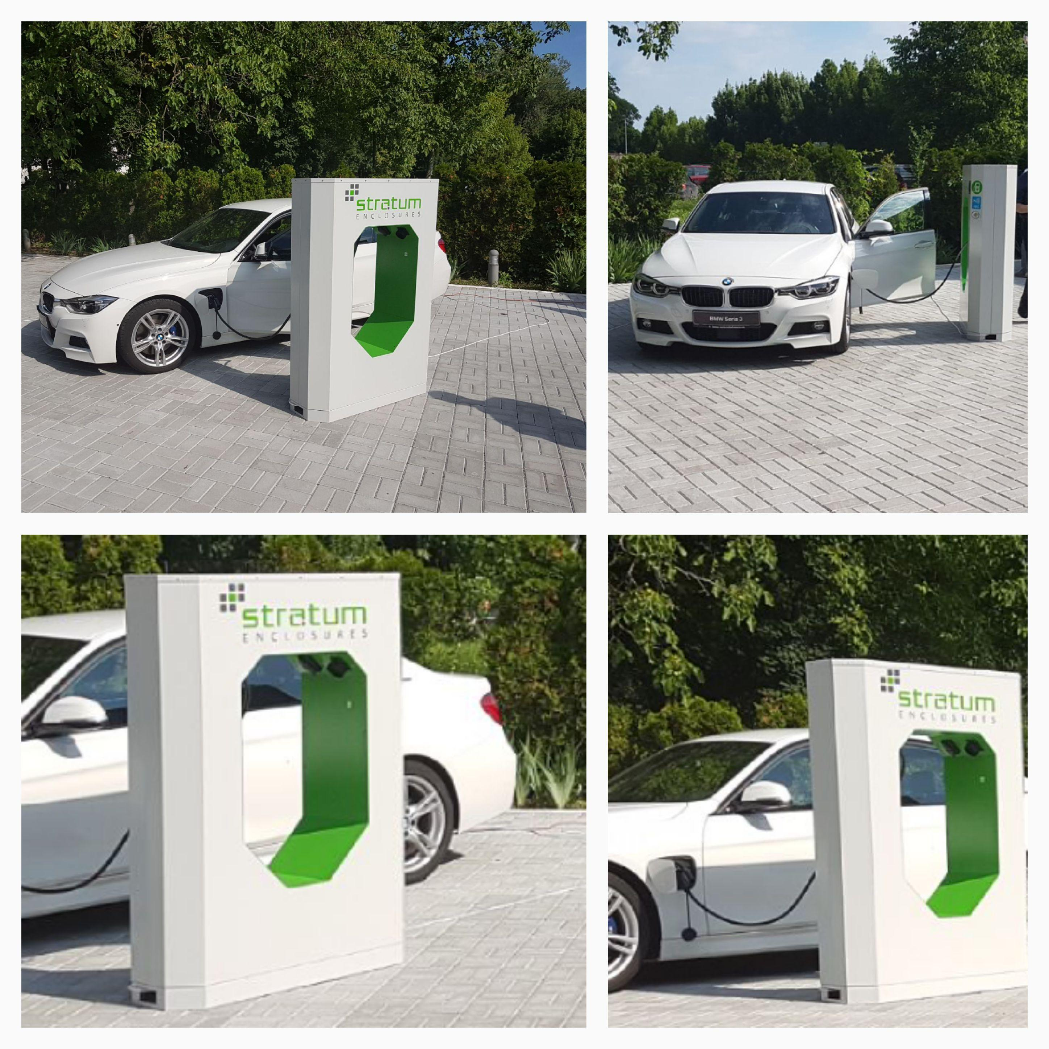
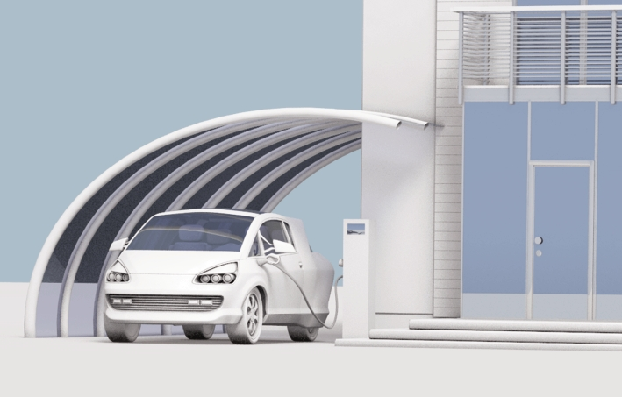
EV-Charging CHARGING SITES

Slide 12
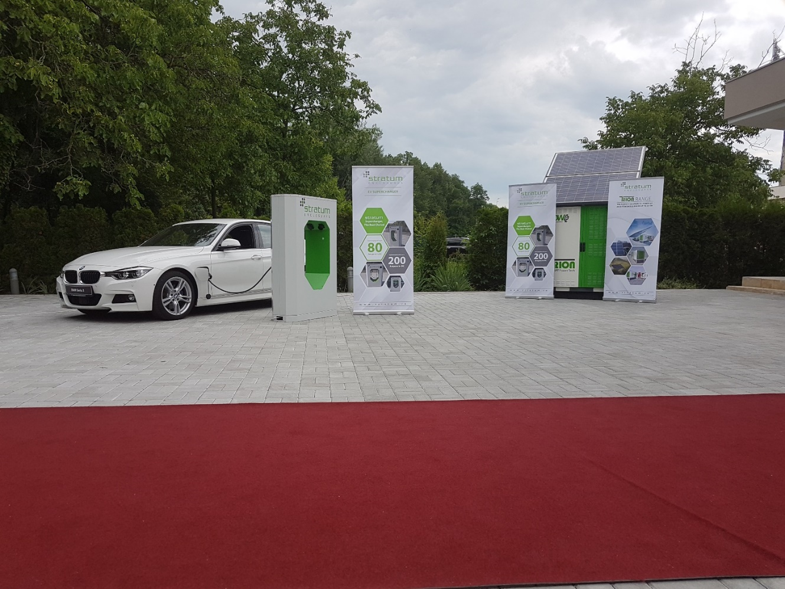
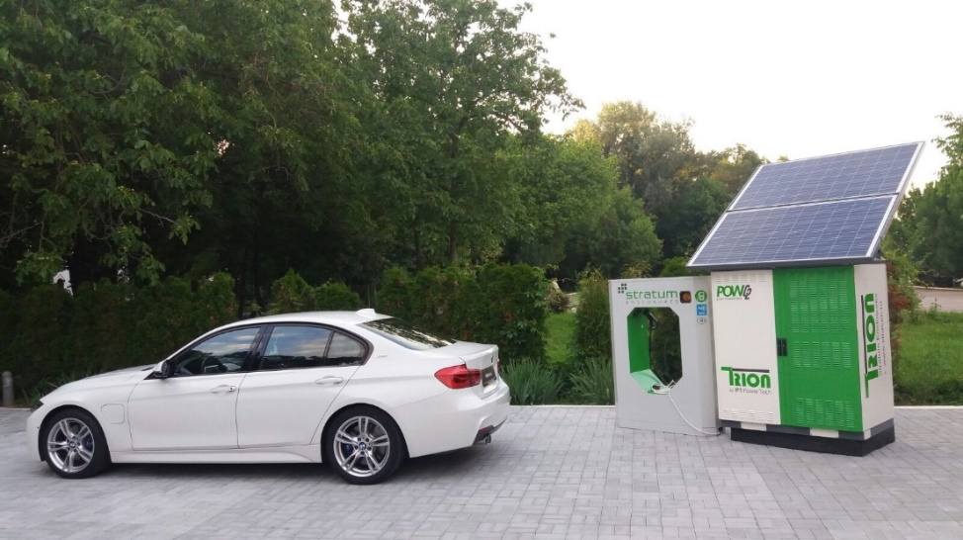
EV-Charging CHARGING SITES

Slide 13
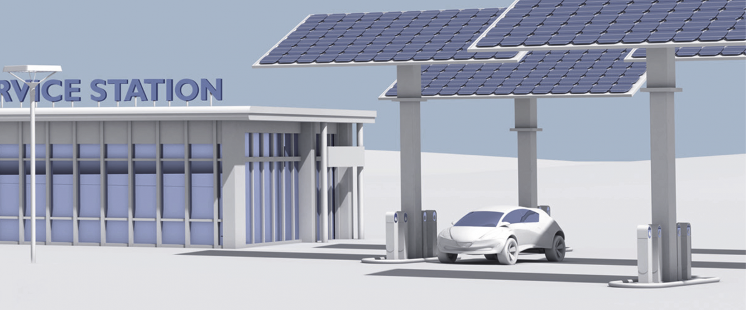
EV-Charging CHARGING SITES

Slide 14
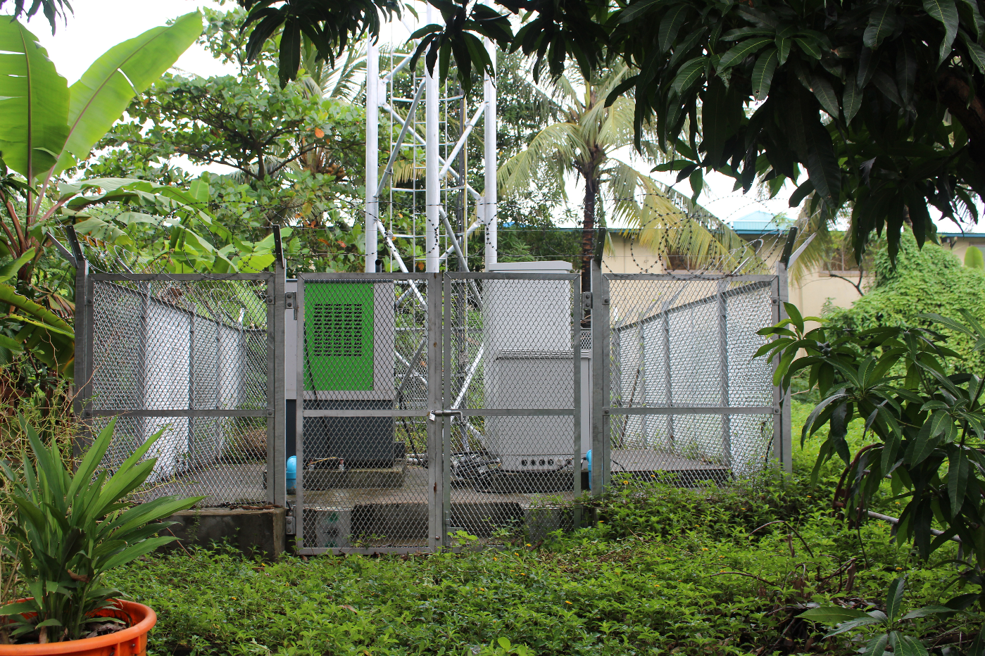
Our Projects
Energy storage

Slide 15
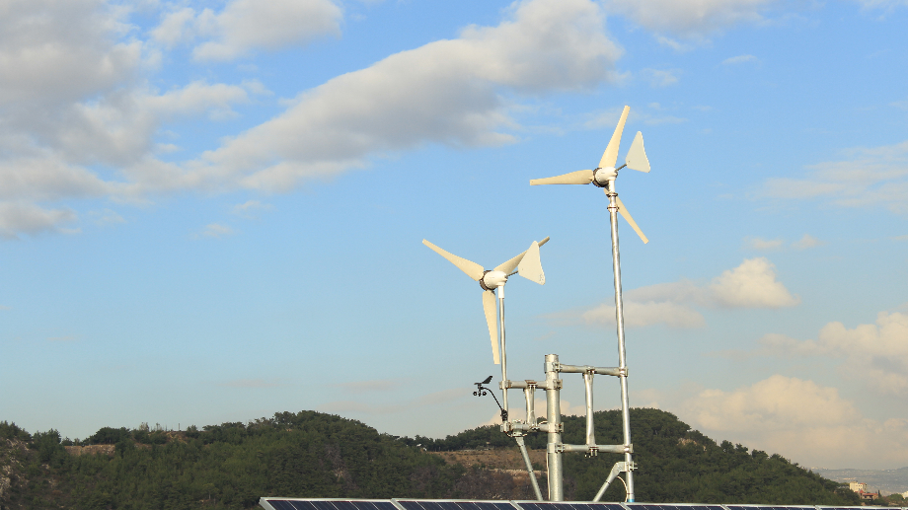
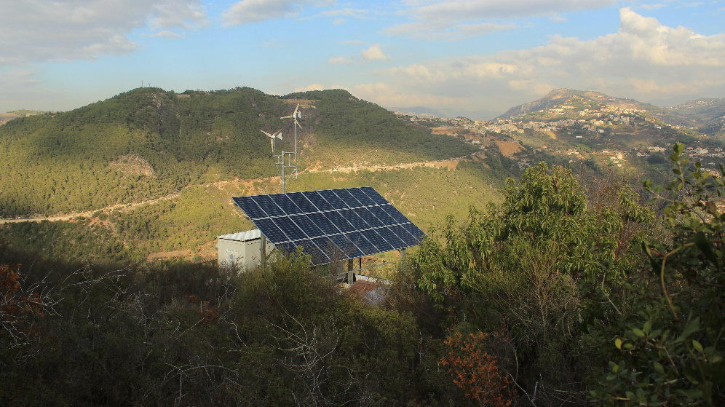
Our Projects
Energy storage

Slide 16
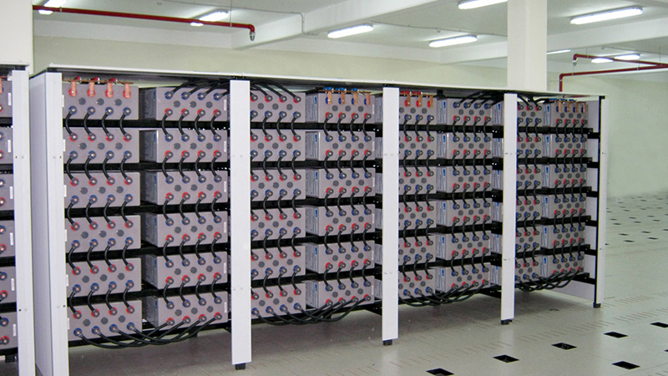
Our Projects
Nigeria-energy storage

Slide 17
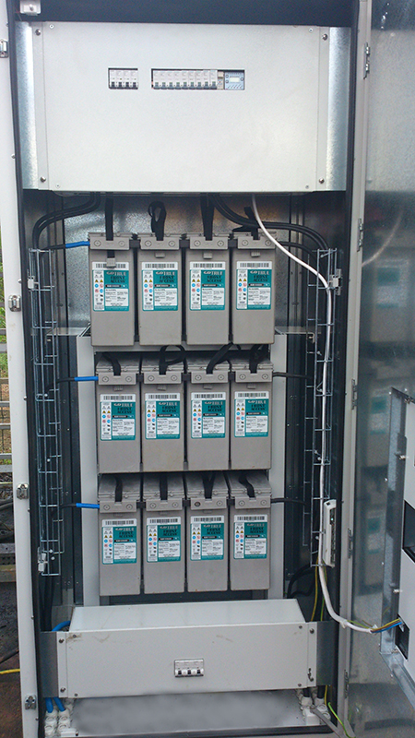
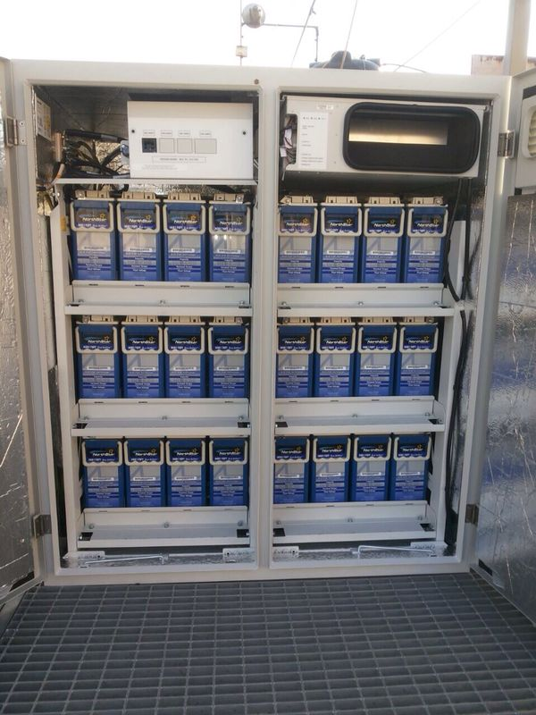
Our Projects
South Africa-energy storage

Slide 18
READY TO ASSIST YOU
www.stratum.ro

